Slide 1
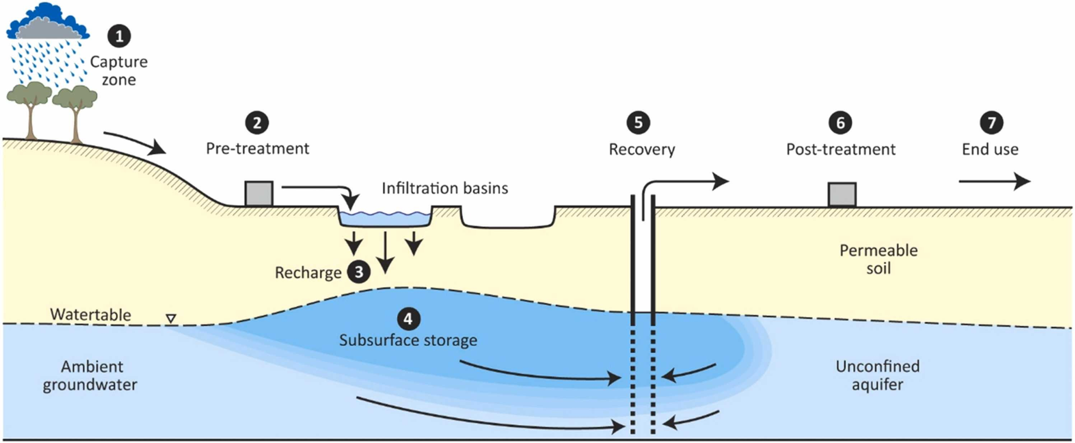



Machine Learning Insights into Artificial Aquifer Recharge
Site suitability analysis in season water availability scenarios
Valdrich J. Fernandes, Perry G.B. de Louw, Coen J. Ritsema and Ruud P. Bartholomeus

Slide 2
Artificial Aquifer recharge
Vanderzalm , et al. (2022)

Slide 3
In the Netherlands?
Longer dry periods in Europe, comparable to the 2018-2020 drought¹
Rakovec, O., et al., 2022

Slide 4
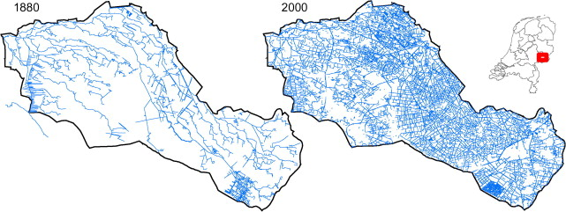
In the Netherlands?
Longer dry periods in Europe, comparable to the 2018-2020 drought¹
Historical focused on discharging water, e.g. for agriculture and cities
Massop, H.Th.L., et al., 2009

Slide 5
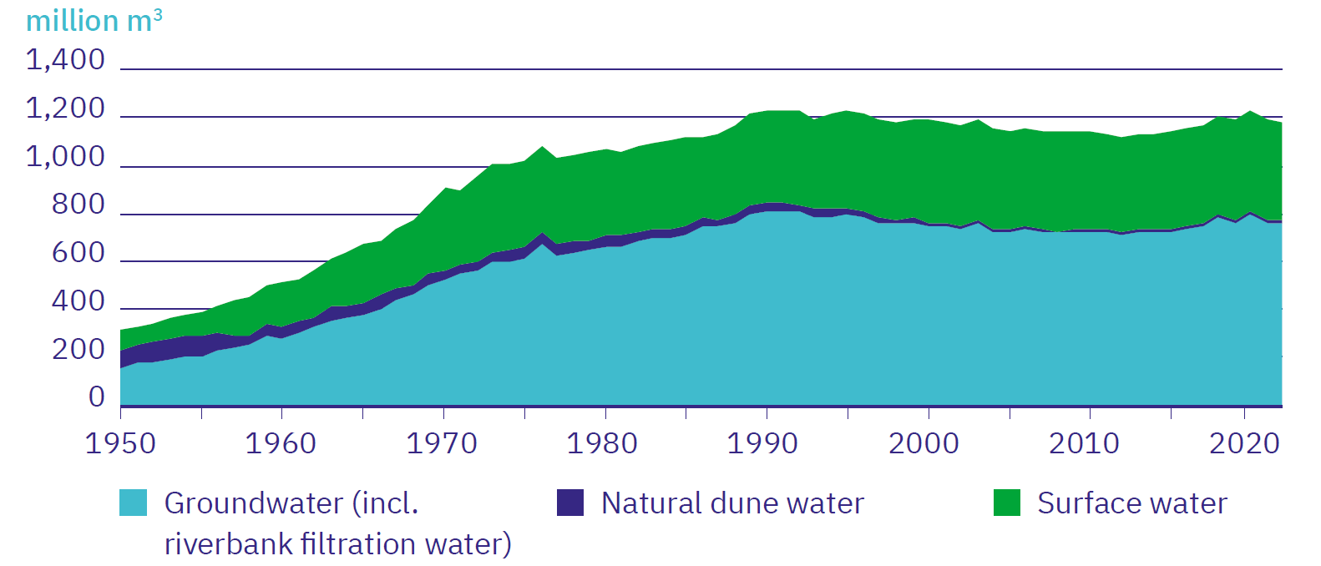
In the Netherlands?
Longer dry periods in Europe, comparable to the 2018-2020 drought¹
Historical focused on discharging water, e.g. for agriculture and cities
Groundwater extraction for drinking water
Nature faces severe desiccation²
Vewin (2023)

Slide 6
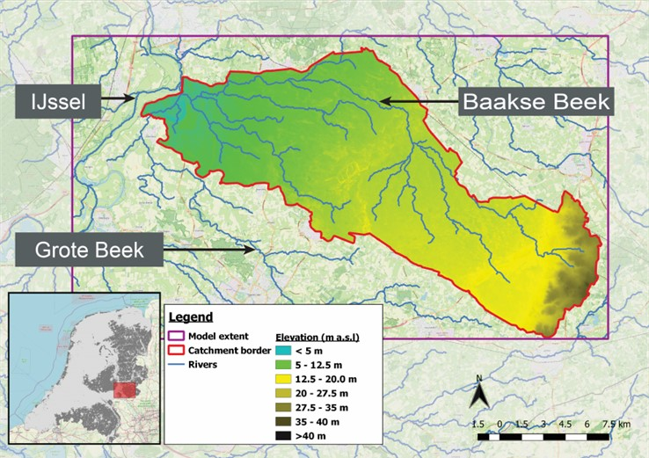
Study area

Slide 7
Artificial Aquifer recharge
From: Vanderzalm , et al. (2022)

Slide 8
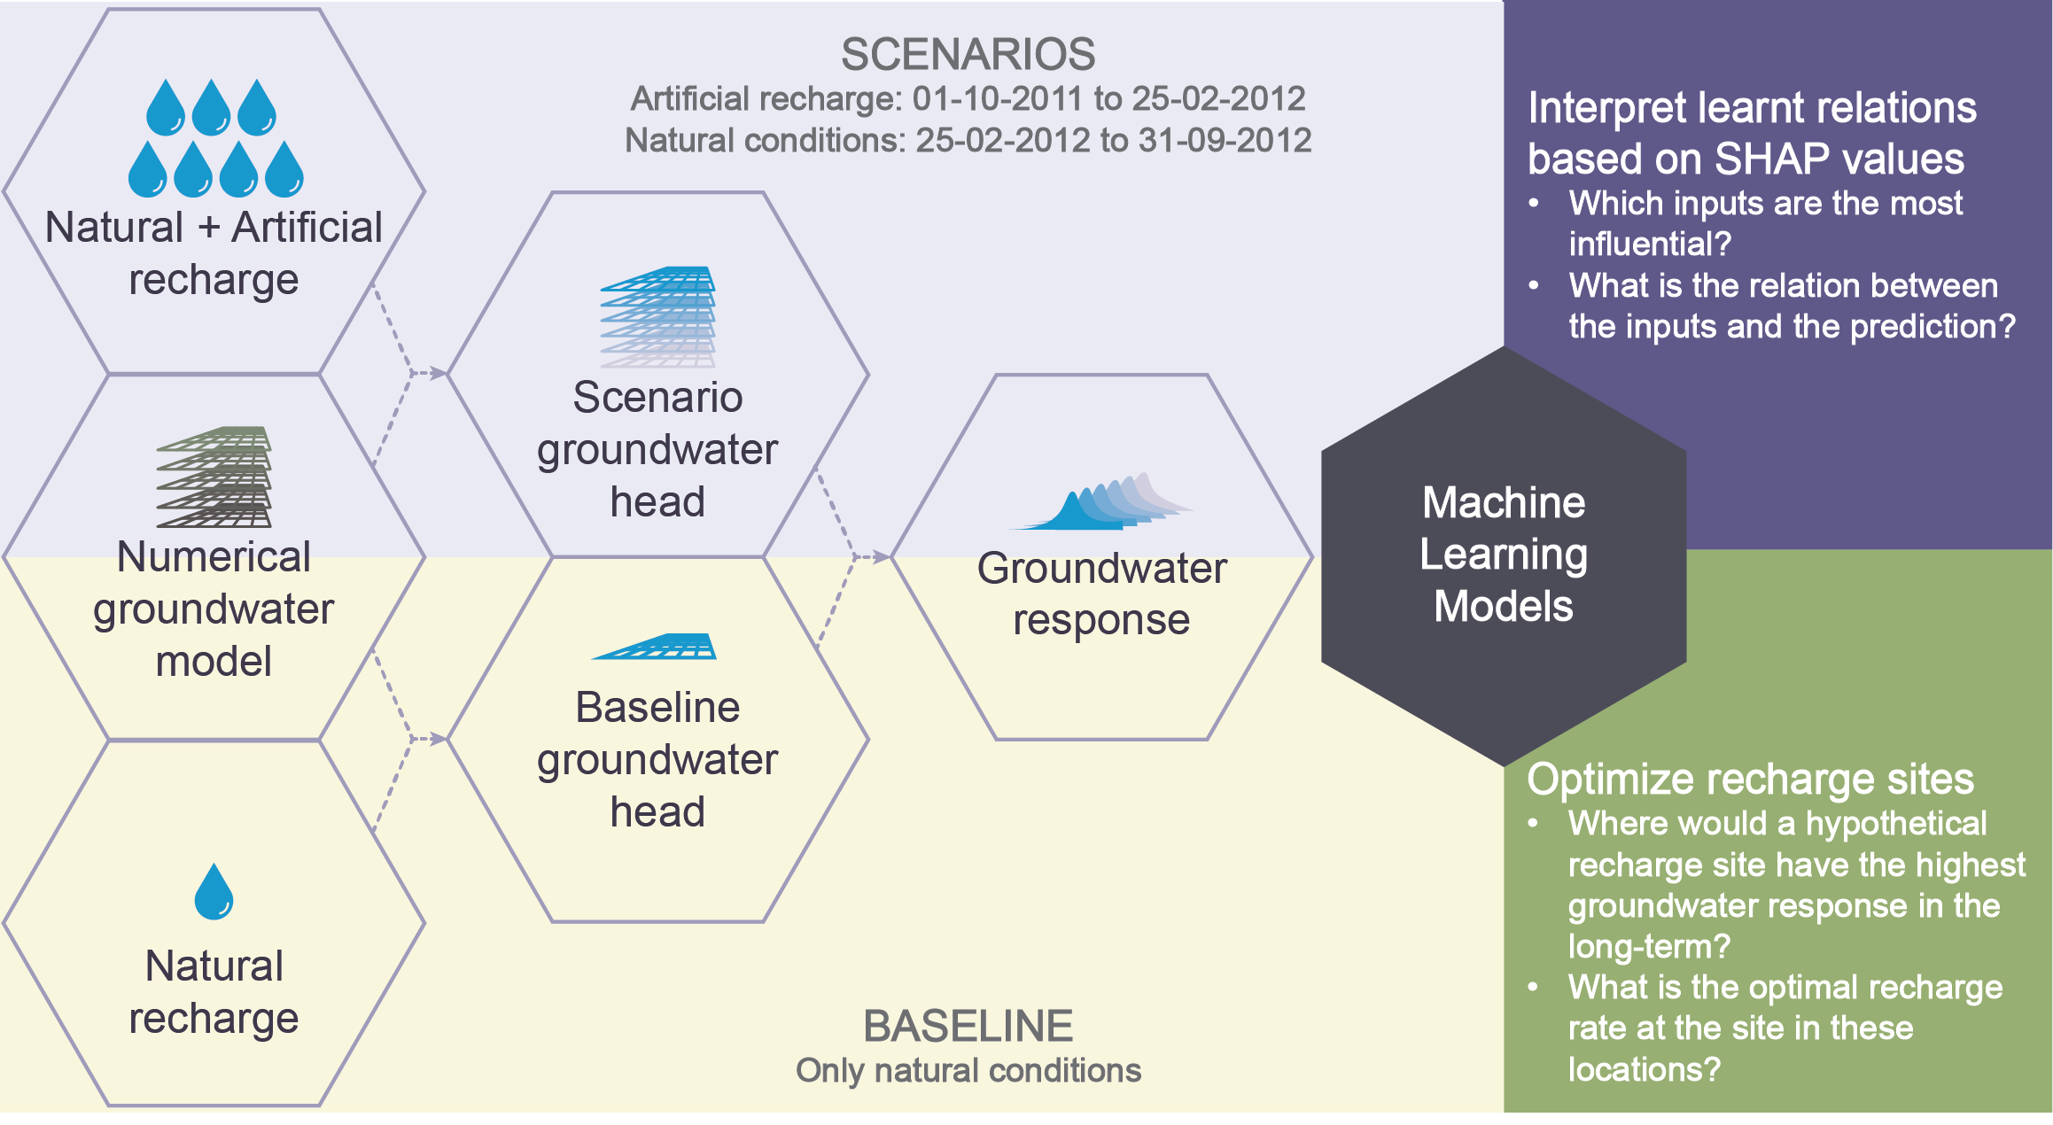
Methodology

Slide 9
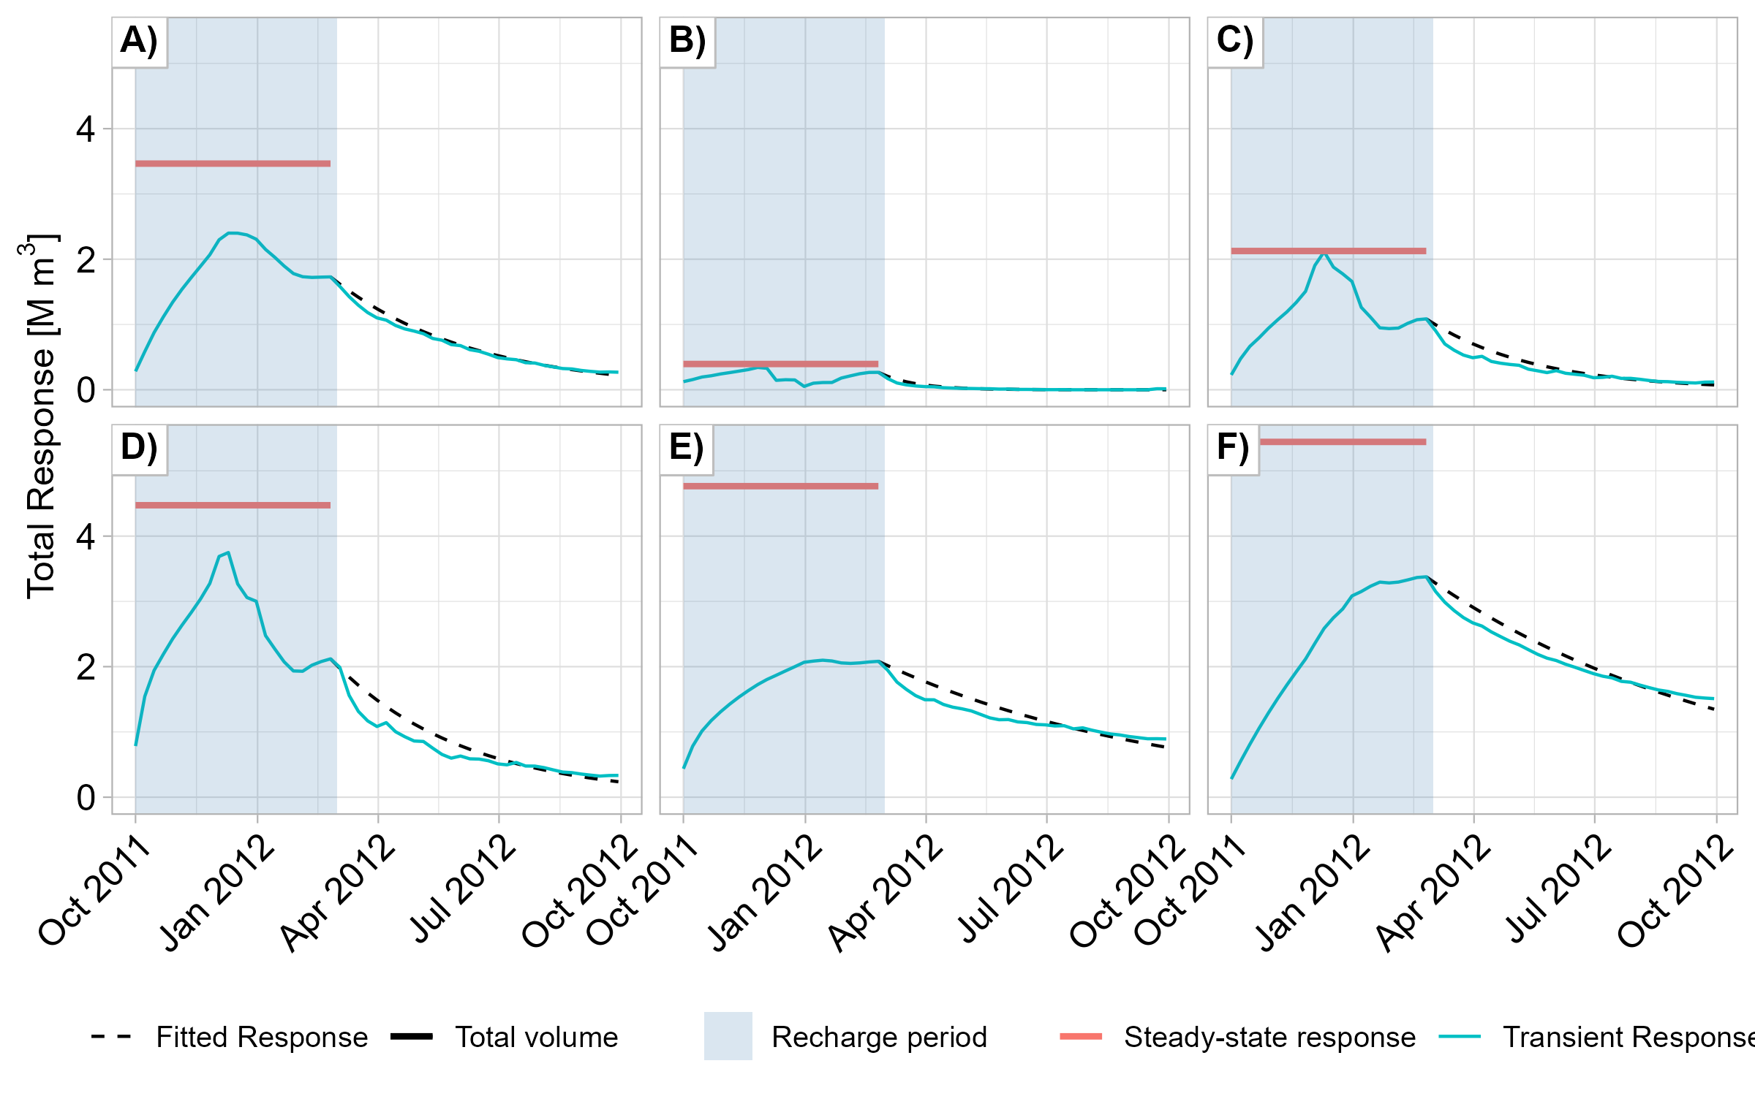



Simulation results
$$S_{0}$$
$$S_{t}=S_{0}×ⅇ^{−kt}$$
$$e^{−kt}$$

Slide 10
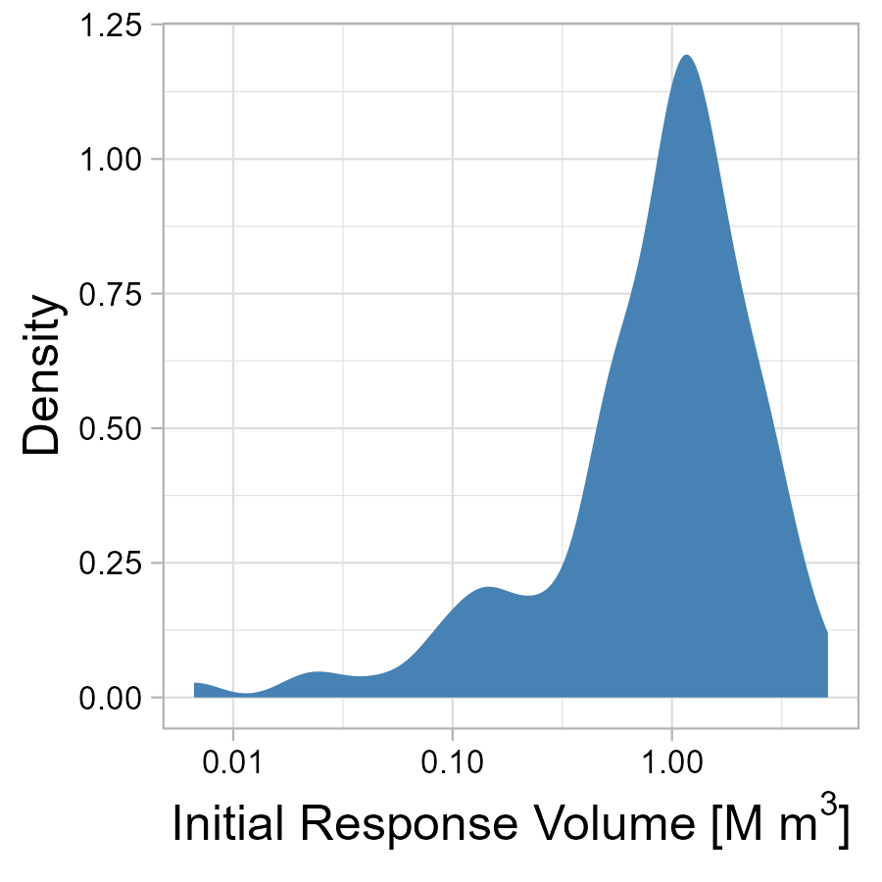
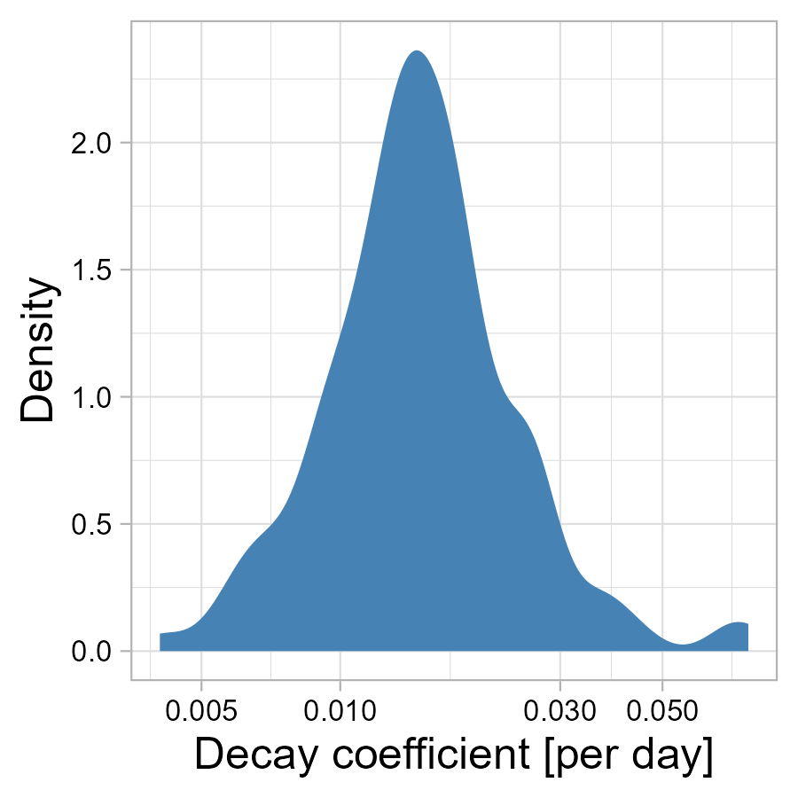
Simulation results

Slide 11
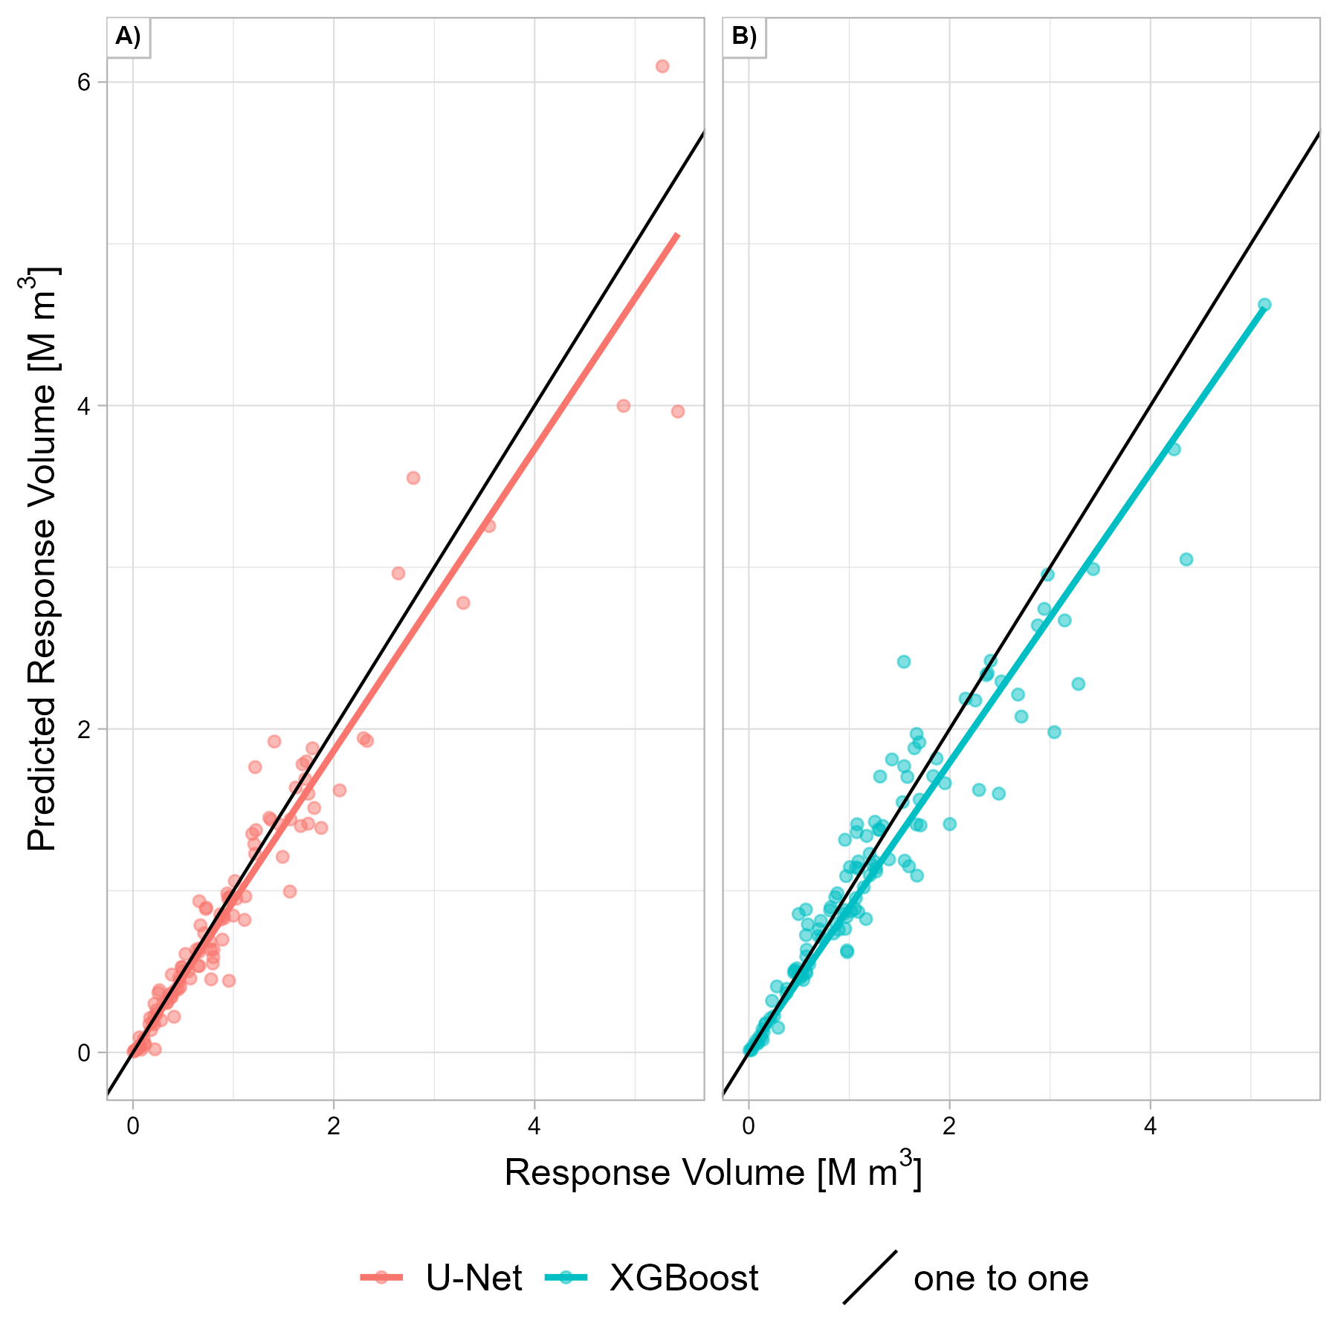
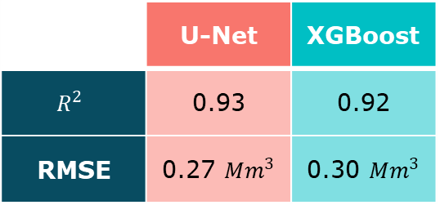
ML model performance – Initial response
 | U-Net | XGBoost
$$R^{2}$$ | 0.93 | 0.92
RMSE | 0.27 ${Mm}^{3}$ | 0.30 ${Mm}^{3}$

Slide 12
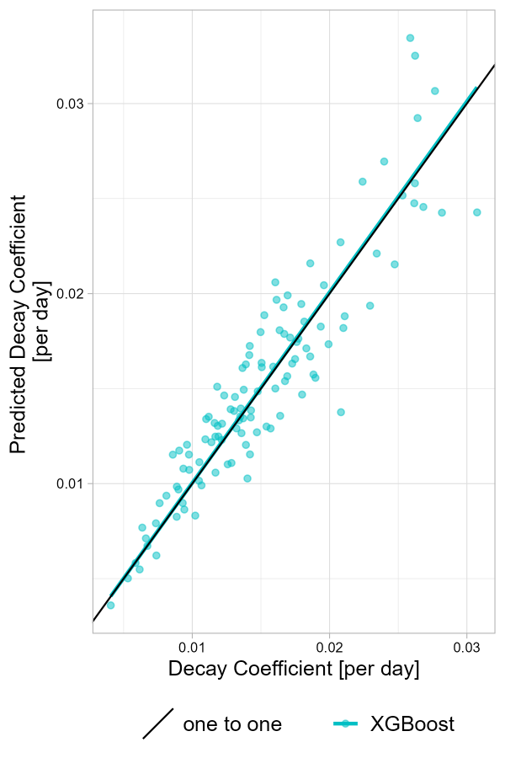
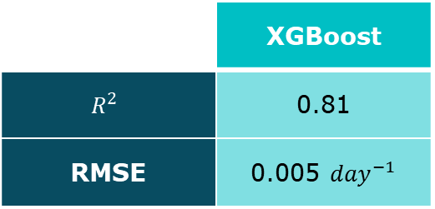
ML model performance – Decay coefficient
 | XGBoost
$$R^{2}$$ | 0.81
RMSE | 0.005 ${day}^{−1}$

Slide 13
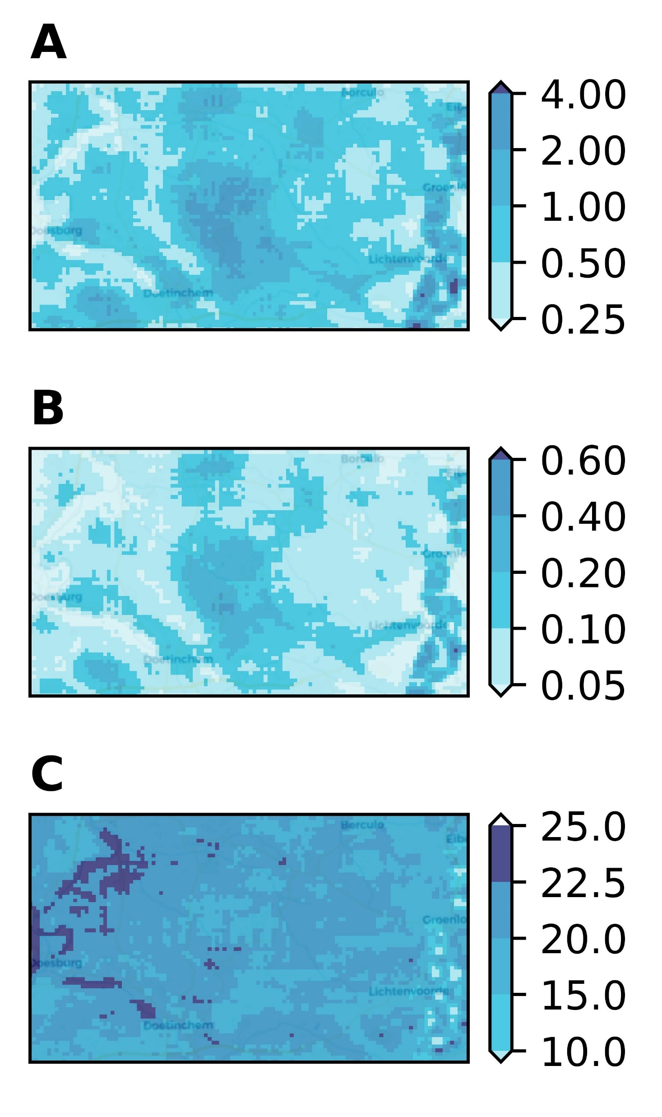
Optimizing Steady-state response
Response volume [million m3]
11 recharge rates at 7744 site, for a total of 84,942 scenarios
Completed in 16.5 minutes with ML vs 270 days with the numerical groundwater model
East and center of the study area stand out
Stored water [million m3]
Optimal recharge rate [mm/day]

Slide 14
Effect of inputs – Initial response
Redacted
Non-linear relations
Site choices [A, B] are the most important
Among the aquifer properties [C, H, I], Porosity is the most important
Followed by surface network properties [D, F,G]
Smaller response if shallow groundwater [E]

Slide 15
Effect of inputs – Decay coefficient
Redacted
Non-linear relations
Very small sites – quicker decay [A]
Aquifer properties are much more important [C, H]
Among surface network properties, river conductance [D] is the most important
Shallow groundwater – quicker decay [E]

Slide 16
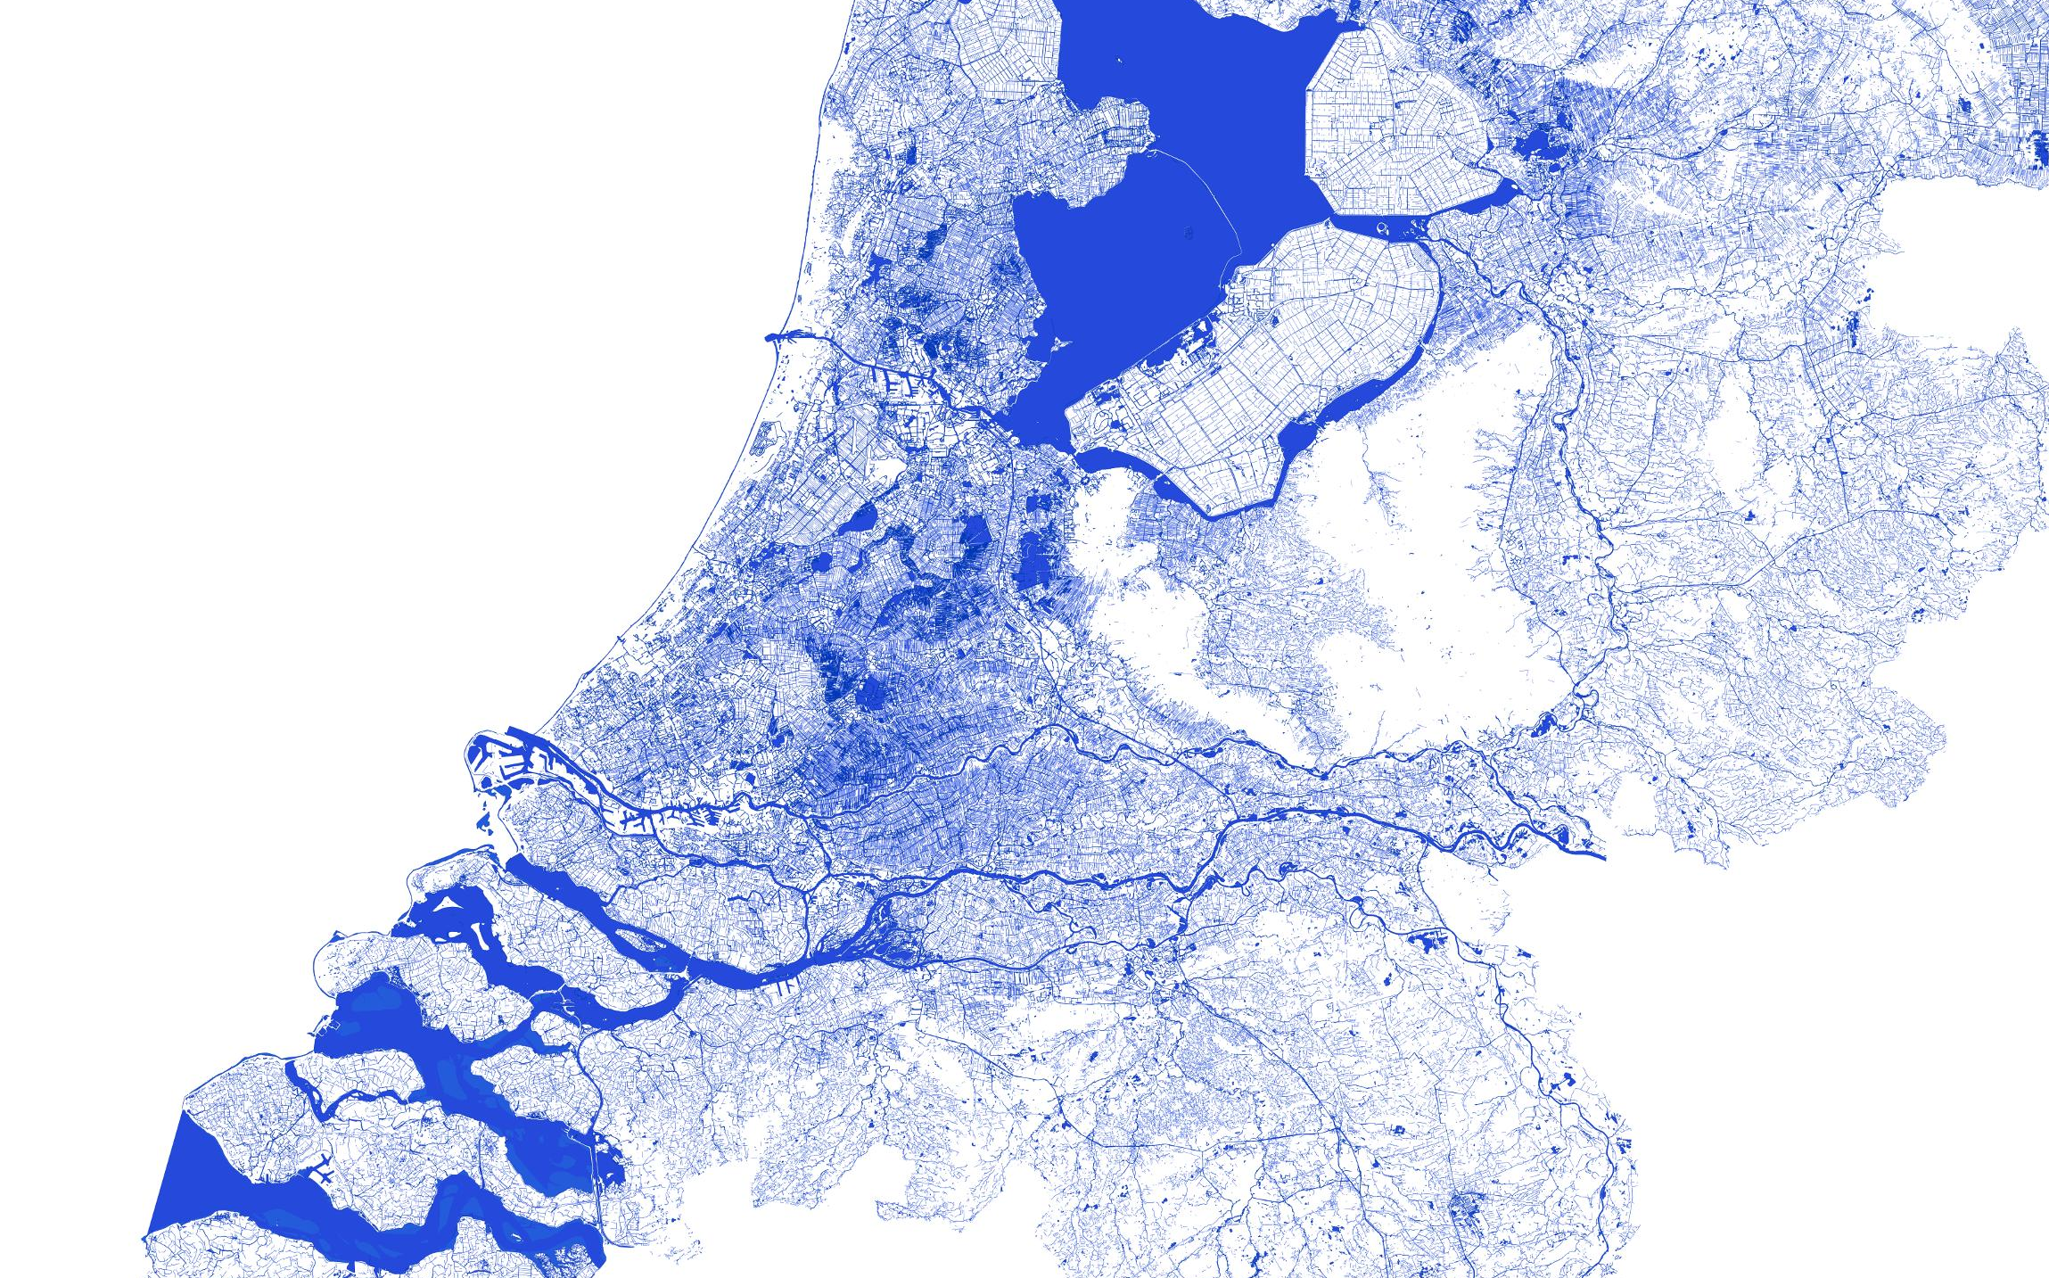

Summary
Machine Learning can accurately estimate the response to artificial recharge, near instant estimates
Non-linear relations can be identified by leveraging explainable AI
valdrich.fernandes@wur.nl

