Slide 1
DeepOryza: A knowledge-guided machine learning model for rice growth simulation
Jingye Han
Ioannis N. Athanasiadis, Liangsheng Shi
Notes:
My presentation is about machine learning model for crop modeling.
The model was named as DeepOryza, it is a knowledge-guided machine learning model for rice growth simulation,

Slide 2
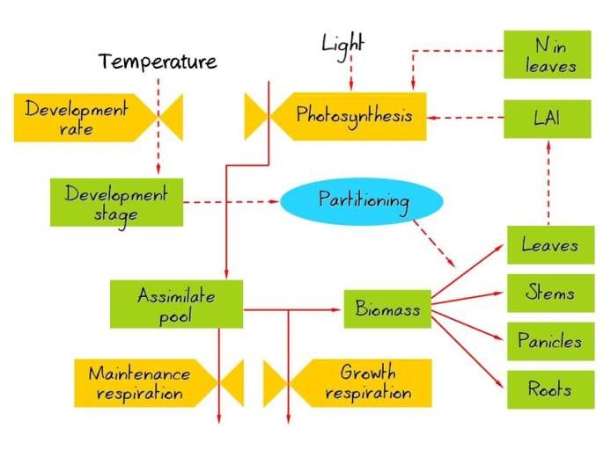
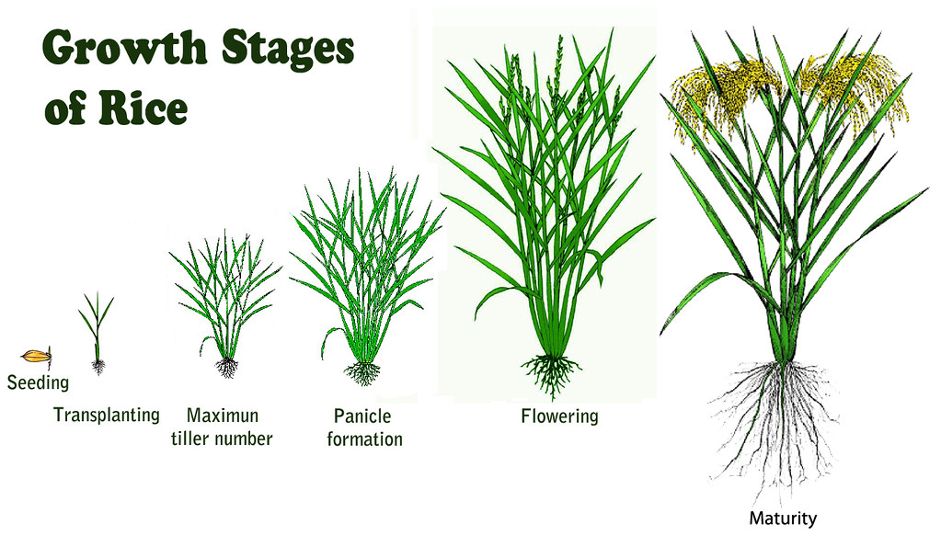
Introduction-How to simulate crop growth
Crop model
Crop Environment
modeling
Crop growth
Simplification
Structure error
The interaction of crop variables
Notes:
Here is a schematic diagram of crop growth.
Scientists use crop growth models to simulate crop growth. And crop models could describe the interaction between crop and environment.
When we zoom in on the crop model, we find that a complex network describes the relationship between many variables.
This net was built based on the knowledge of crop physiology.
These models were called process-based models.
However, as you can imagine, there are many simplifications in the model.
These simplifications introduce structural errors into the crop models.
Therefore, we need to find a method that can reduce structural errors and improve model accuracy."

Slide 3
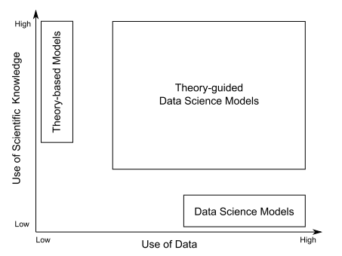
Introduction-What knowledge-guided machine learning is
New paradigm
Ways to implement the KGML
Knowledge-guided loss
Physics Guided RNNs for Modeling Dynamical Systems: A Case Study in Simulating Lake Temperature Profiles.2019
Knowledge guided Structure
Knowledge-guided initialization
KGML-ag: a modeling framework of knowledge-guided machine learning to simulate agroecosystems. 2022
——Karpatne et al., 2017
KGML
Crop model
Process-based(PB) Crop model Knowledge
Theory-guided Data science model
Physic-guided machine learning
Knowledge-guided machine learning
Observation Dataset
1、Can we build a crop model from data and knowledge to improve model performance?
2、How could domain knowledge assist in building new crop models?
Notes:
Now there is a new opportunity for crop growth simulation as more data and methods are available.
A new paradigm that combines data and knowledge has emerged.
This paradigm goes by different names, such as theory-guided data science models, physics-guided machine learning, or knowledge-guided machine learning.
Regardless of what it is called, it is a method that takes advantage of both knowledge and data.
In my research, I refer to it as knowledge-guided machine learning.
Researchers have explored this concept in other fields, and there are common ways to implement the knowledge guild machine learning，such as:
Knowledge-guided loss: Designing the loss function based on knowledge.
Knowledge-guided structure: Designing the model structure based on domain knowledge.
Knowledge-guided initialization: Using the data generated by a process-based model to pre-train the machine learning model.
The goal is to leverage the knowledge embedded in the process-based model for the machine learning model.
Two questions need to be answered:
1、Can we build a crop model from data and knowledge to improve the model performance?
2、How can domain knowledge assist in building new crop models?

Slide 4
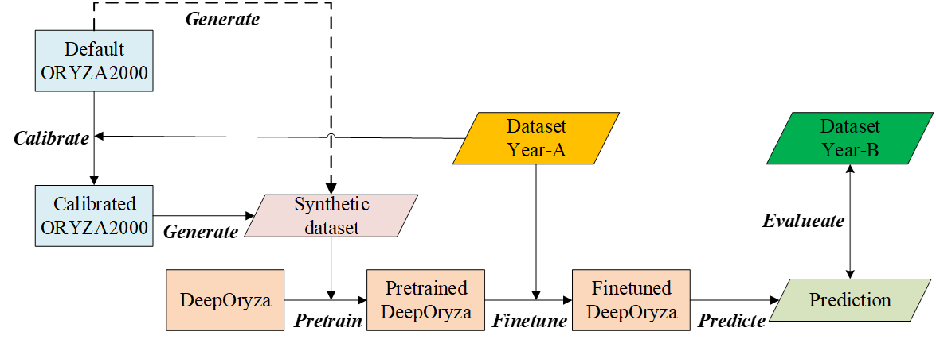
Method and dataset——Flowchart
Synthetic dataset generation
Model pretraining
Model finetuning
Model evaluation
Notes:
In this research, we design a flowchart to investigate the questions.
As you can see the figure or the text on the left side.
First, we generated a synthetic dataset with a processed-based model ORYZA2000
The synthetic dataset was used to pretrain the machine learning model.
After that, a real dataset was used to finetune the pretrained model.
The final step is to evaluate the model.

Slide 5
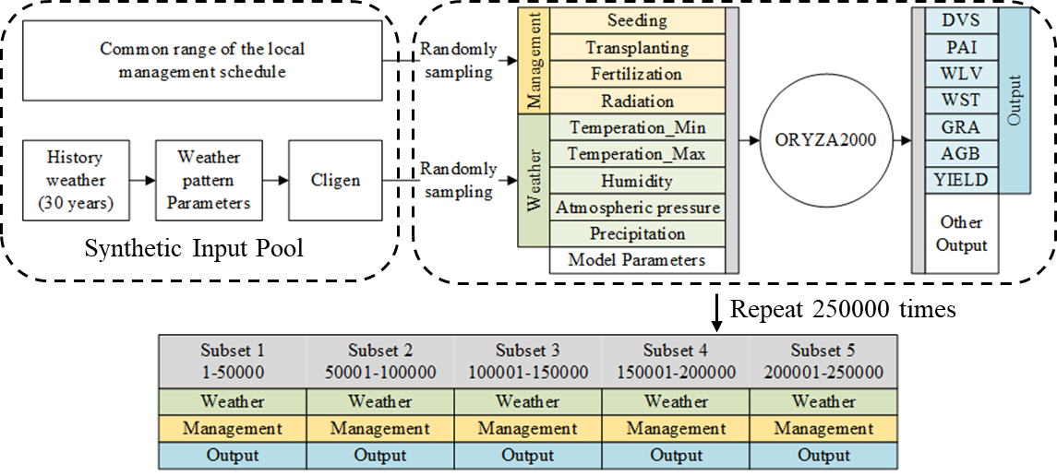
Method and dataset——dataset
Weather (radiation, temperature…)
Management (Fertilization schedule, seed date, transplant date)
Crop state: Development stage, plant area index, biomass of leaf/stem/grain, final yield)
Input
Output/Label
Synthetic dataset
Randomly generated
250k samples
Observations are continuous without missing label
Real dataset
Field collected
105 samples in a two-year experiment
Observations are sparse (3-11 times within a growth season)
Notes:
The dataset consists of input and output parts.
The inputs are the driven variables including weather and management schedule.
The outputs are crop states, including development stage, plant area index, biomass of leaf, stem and grain, and the final yield.
And these seven output variables have corresponding labels.
As we have a synthetic dataset and a real dataset.
The difference between the two datasets is the source of the data. One was randomly generated and the other was from field observation.
The size and the observation frequency of the two dataset were also different.

Slide 6
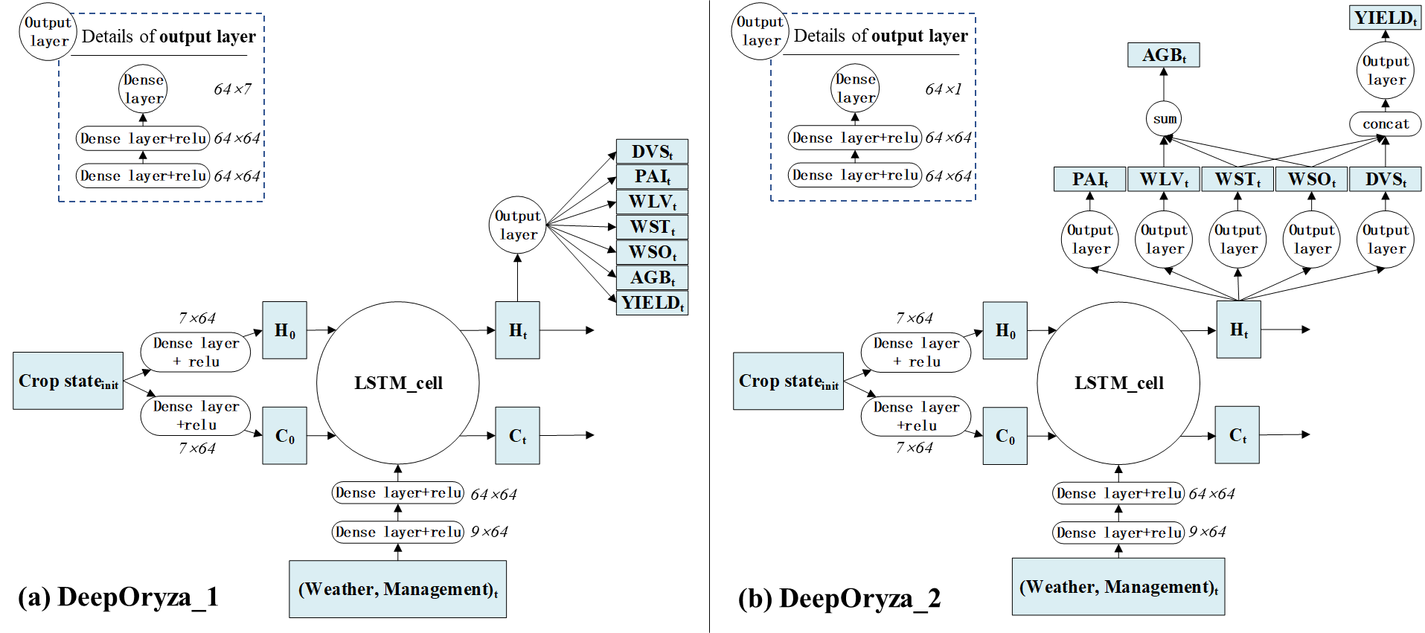
Model and dataset-Model structure designation
DeepOryza_baseline
naïve outputs all simulated variable
(b) DeepOryza_kgml
connecting some variables related to biomass to make each variable constrain each other according to the description of crop growth mechanism and crop model
Notes:
Now, I’d like to give a description of the model structure.
The LSTM model was employed to build the DeepOryza because it can learn long dependencies between variables on time series data.
Let's take a look at the one on the left first.
The time series of weather and management data were used as input and the model directly outputs the simulated crop states as a time series.
The left model is named the DeepOryza_baseline because it simulates crop states without considering their relationships..
The right one was named DeepOryza_kgml, because it was designed by taking into account the relationship between the crop states:
The first structure is that Aboveground Biomass should be the sum of leaf, stem, and storage organ;
The second structure is that the yield should come from the partition biomass of the storage organ and the translocation biomass of the stem

Slide 7
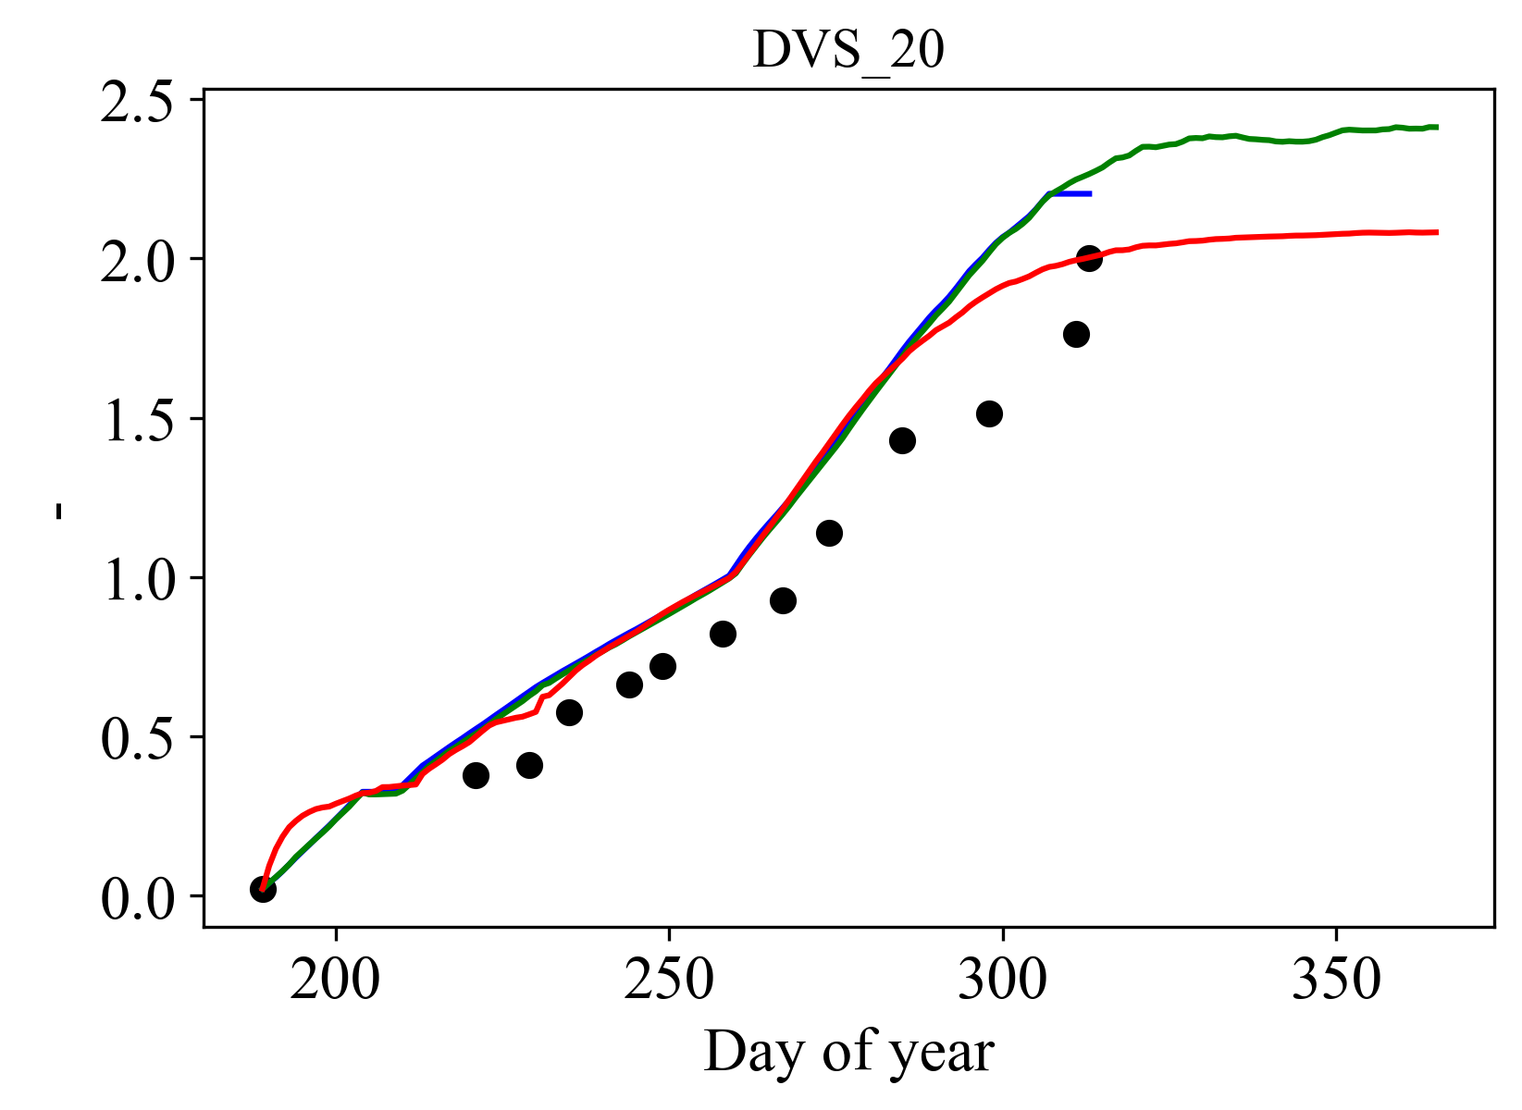
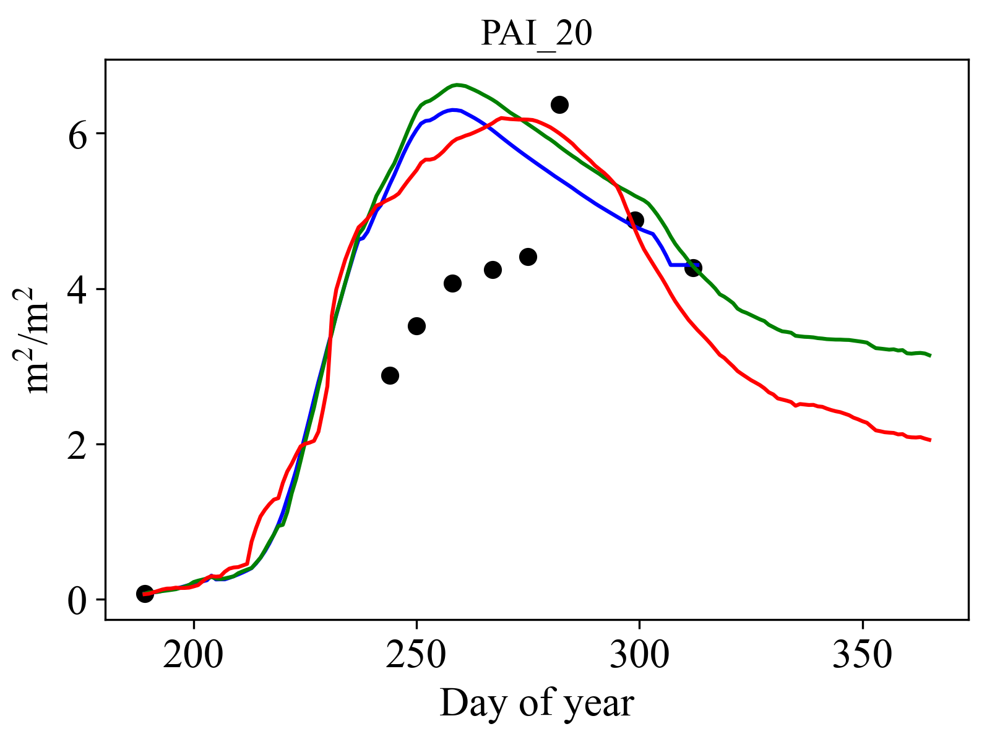
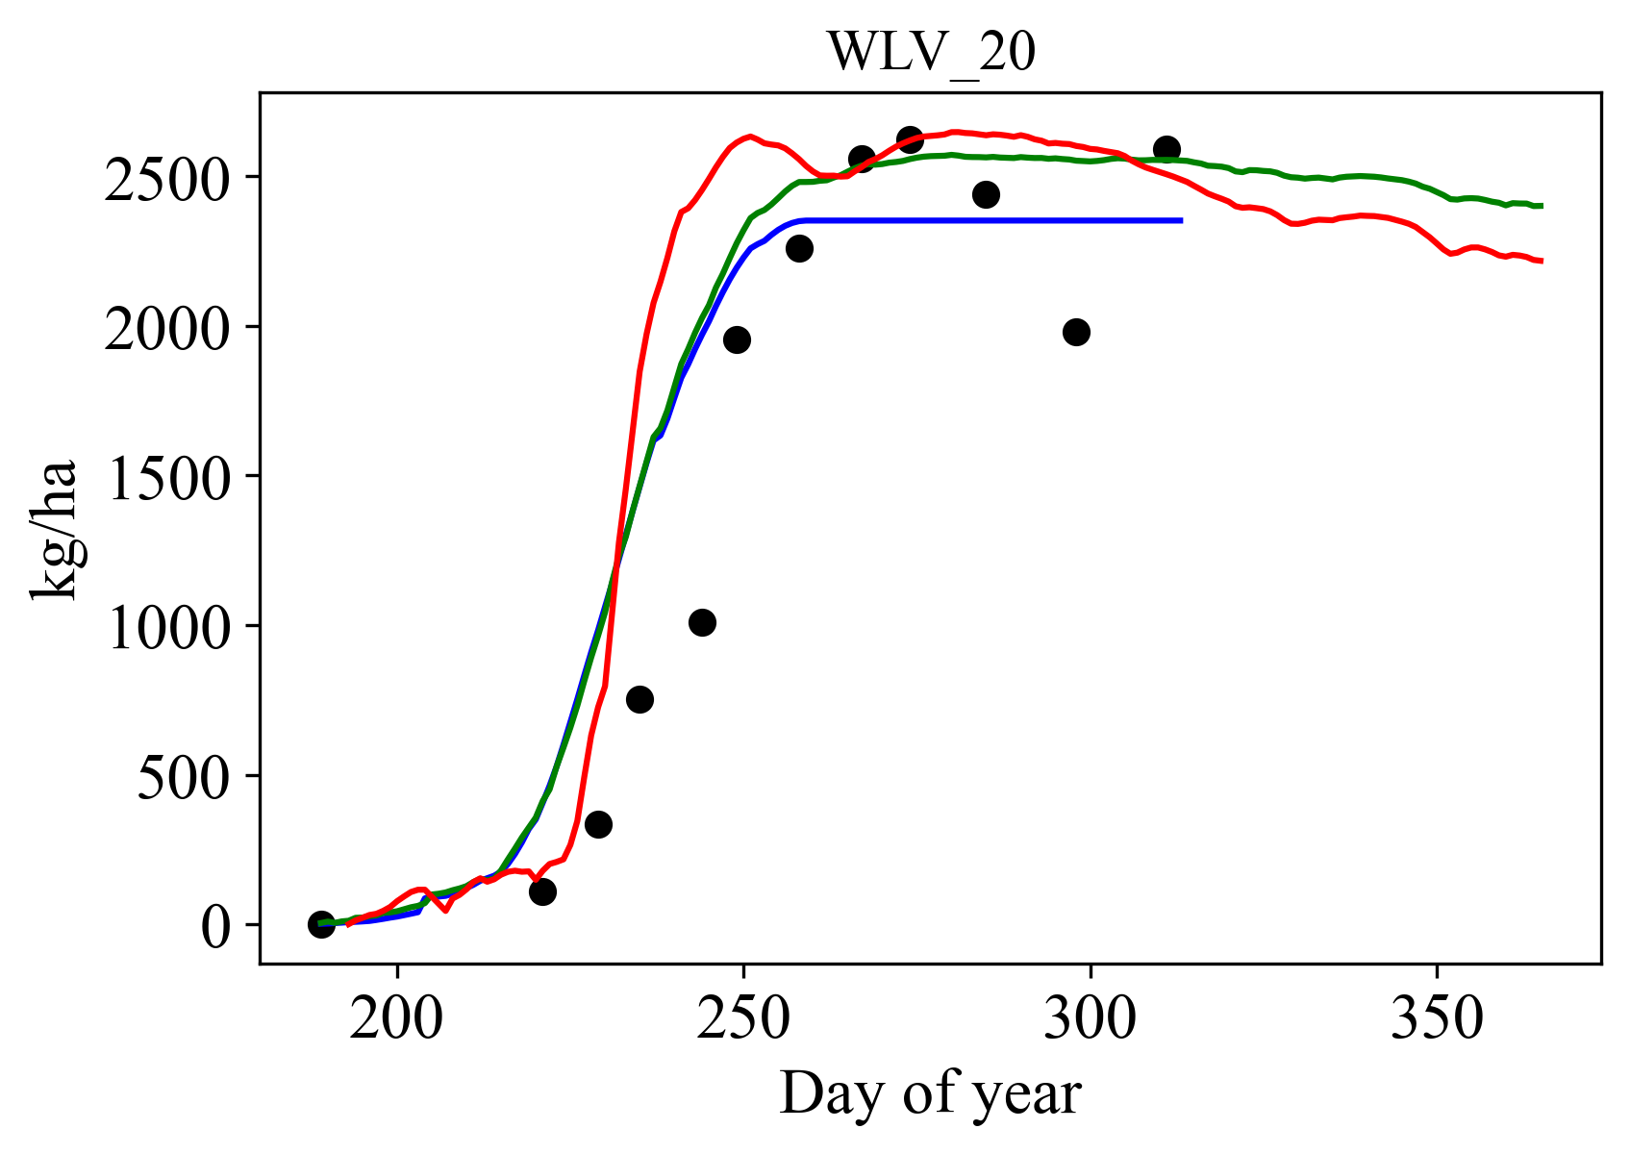
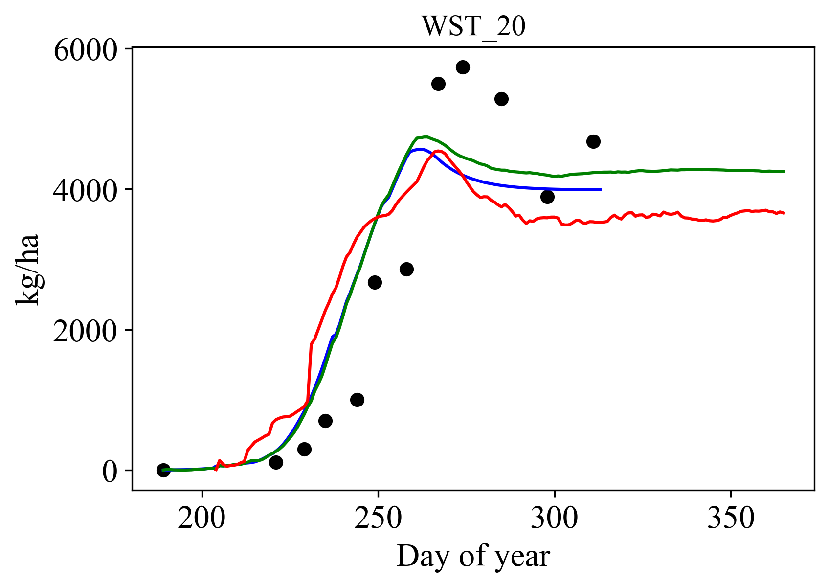
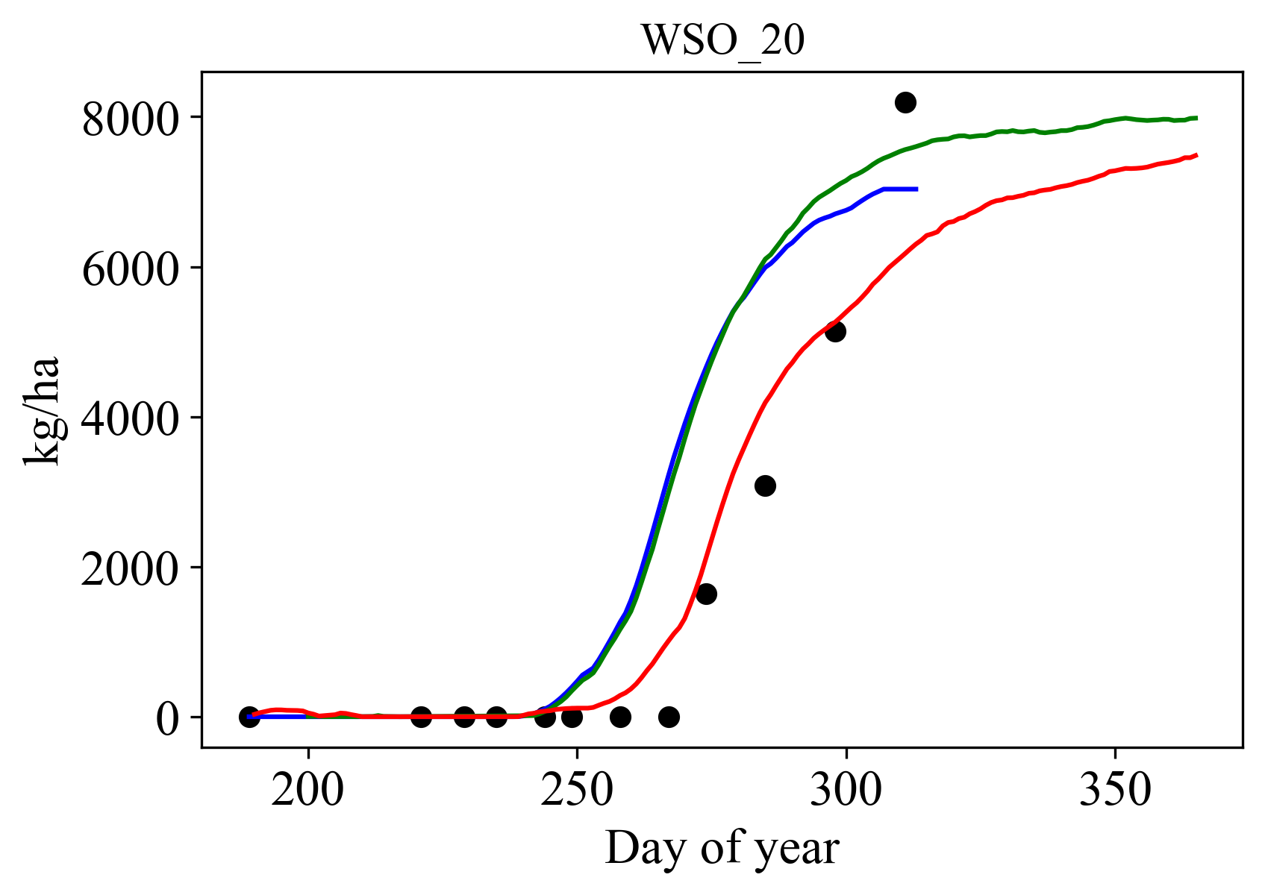
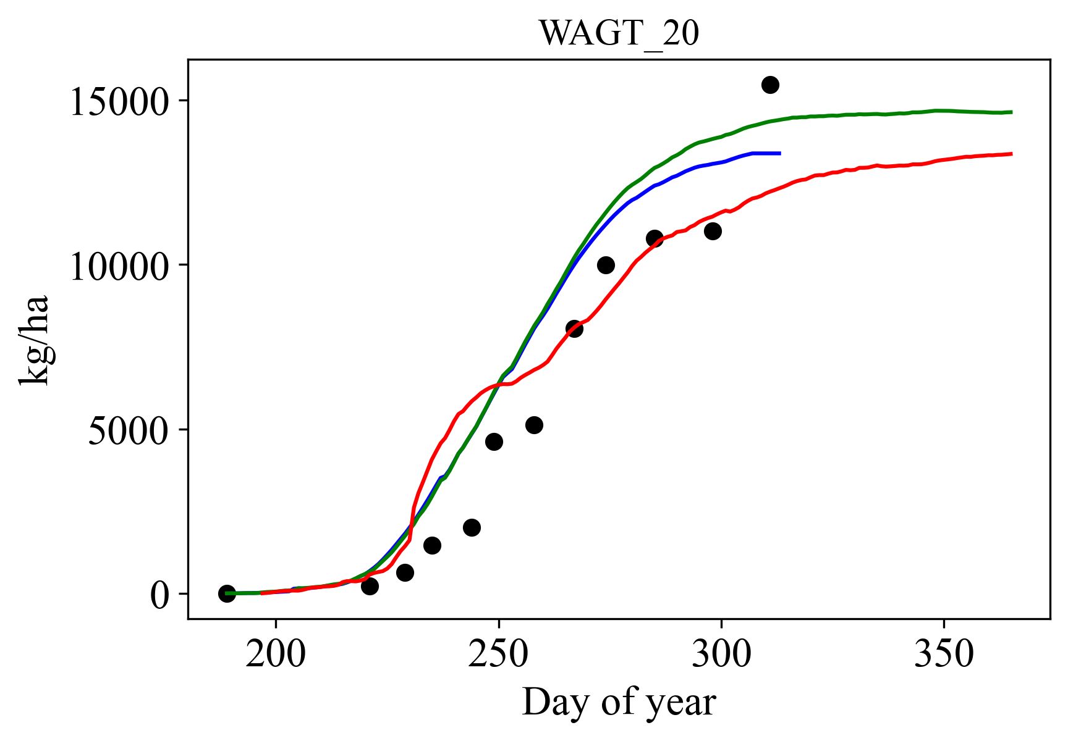
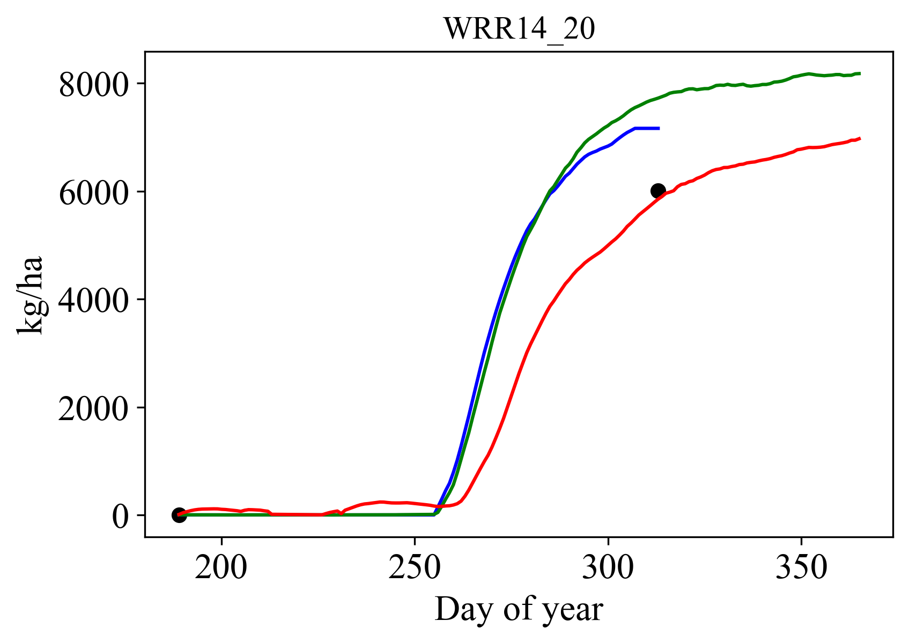
Results and discussion- time series result (improved case)
For question: Can we build a crop model from data and knowledge to improve model performance?
Development stage
Plant area index
Leaf biomass
Stem biomass
Grain biomass
Aboveground biomass
Yield
Note: These results are simulated by DeepOryza_kgml
Notes:
DeepOryza model can be used to simulate crop growth after pertaining and finetuning.
Here is an example of the simulated results of DeepOryza_kgml in the test set.
The blue line shows ORYZA2000 results, while the green and red lines show the pretrained and finetuned machine learning models, respectively.
As you can see, the general growth pattern has not changed much, but the red curves have become closer to the observation points.
Because the changes in results vary across samples, it is difficult to determine the exact nature of these changes. Thus, the seven figures only provide a general overview of the effects of pretraining and finetuning.

Slide 8
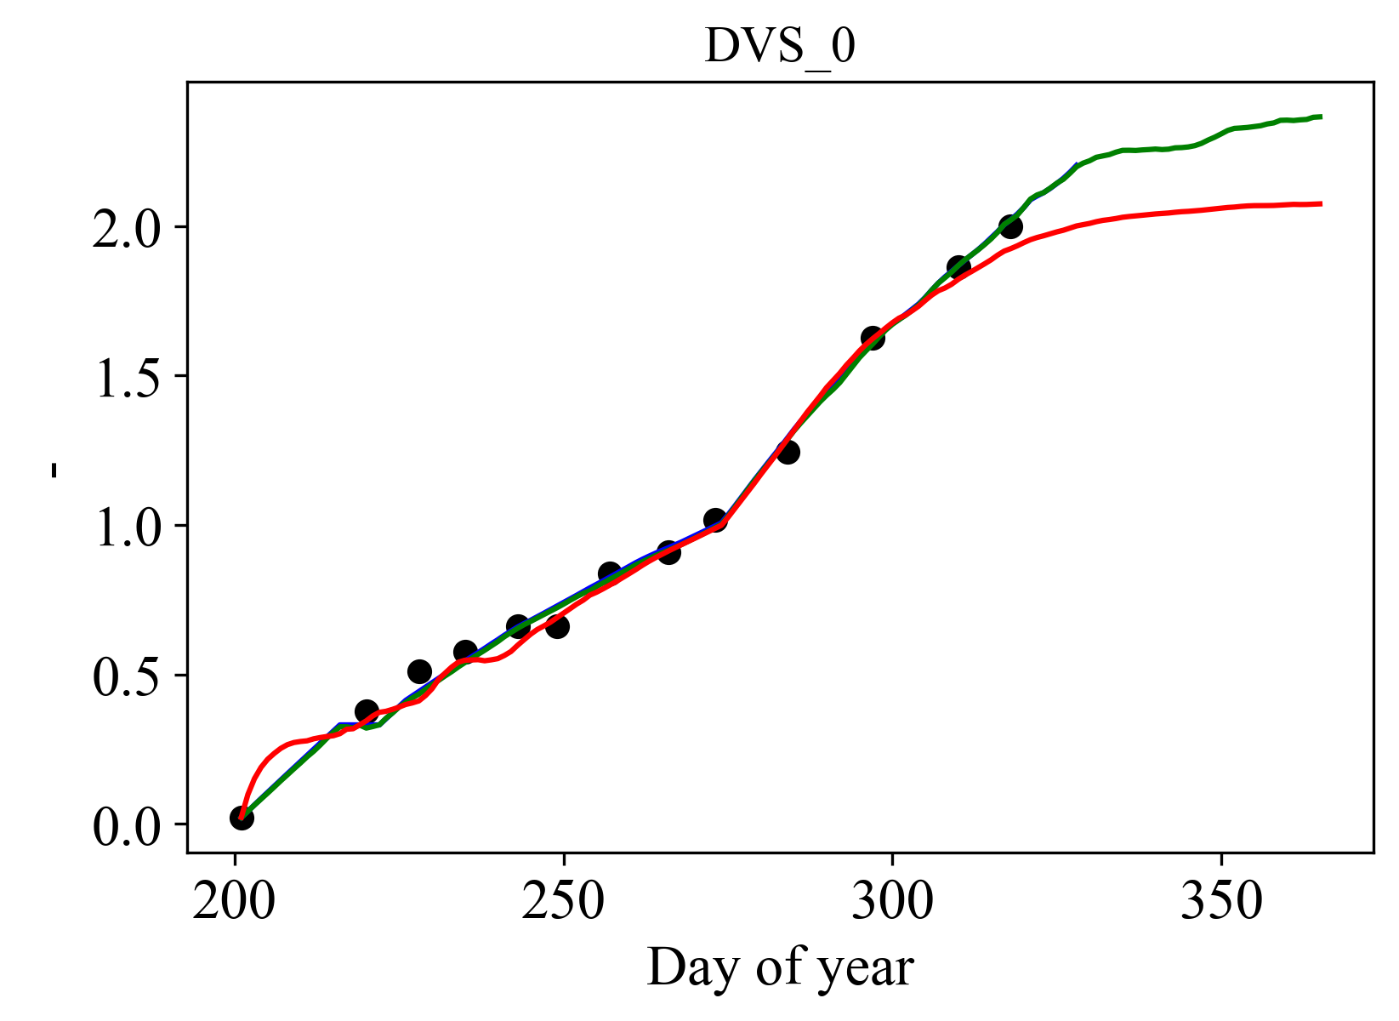
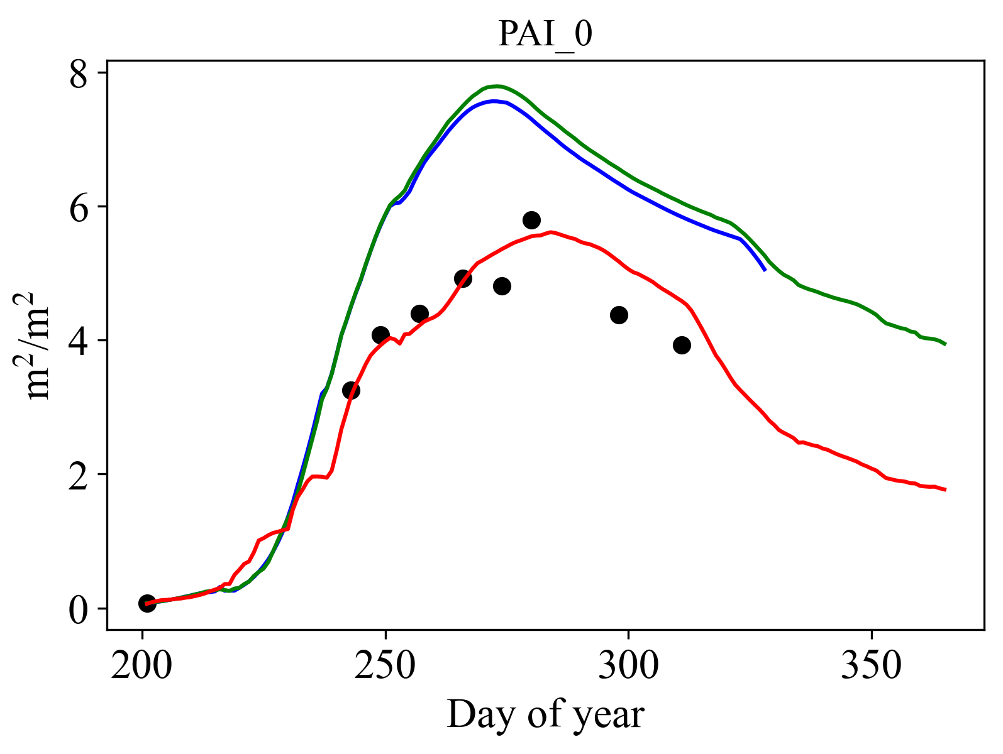
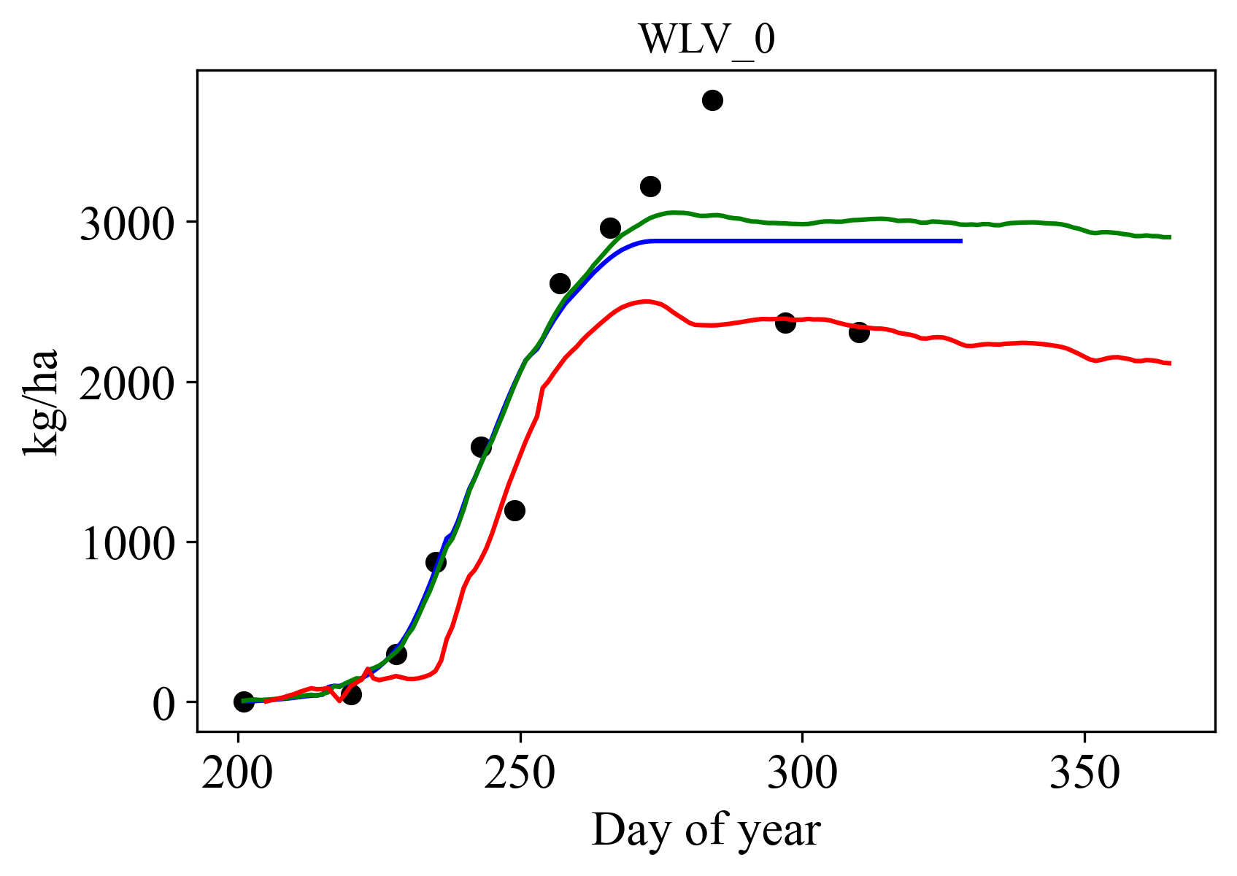
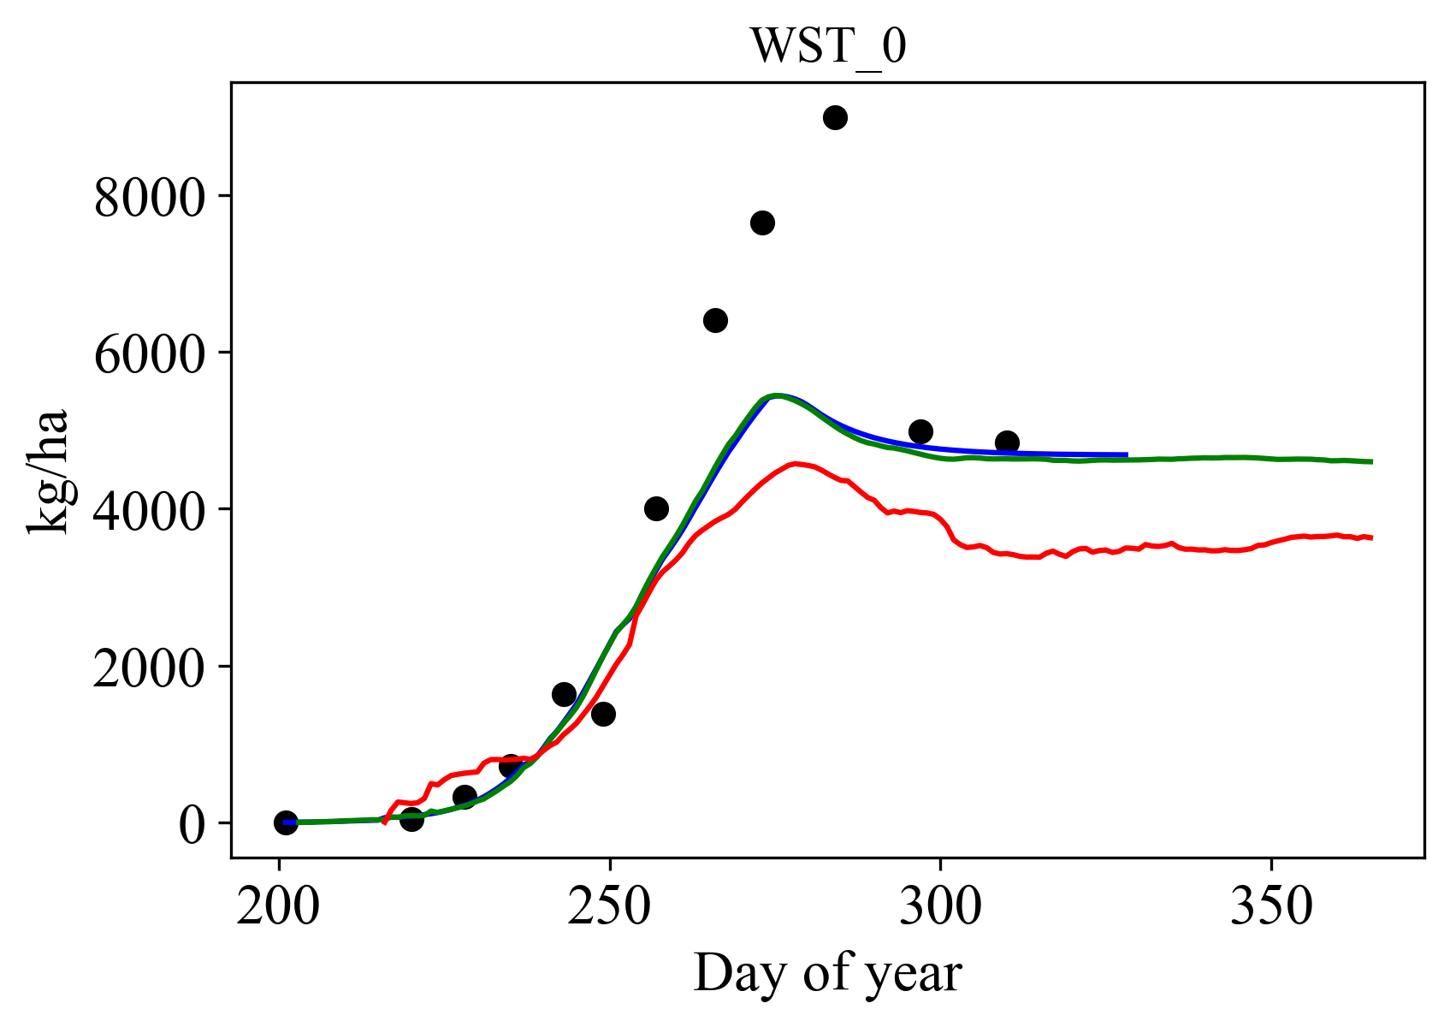
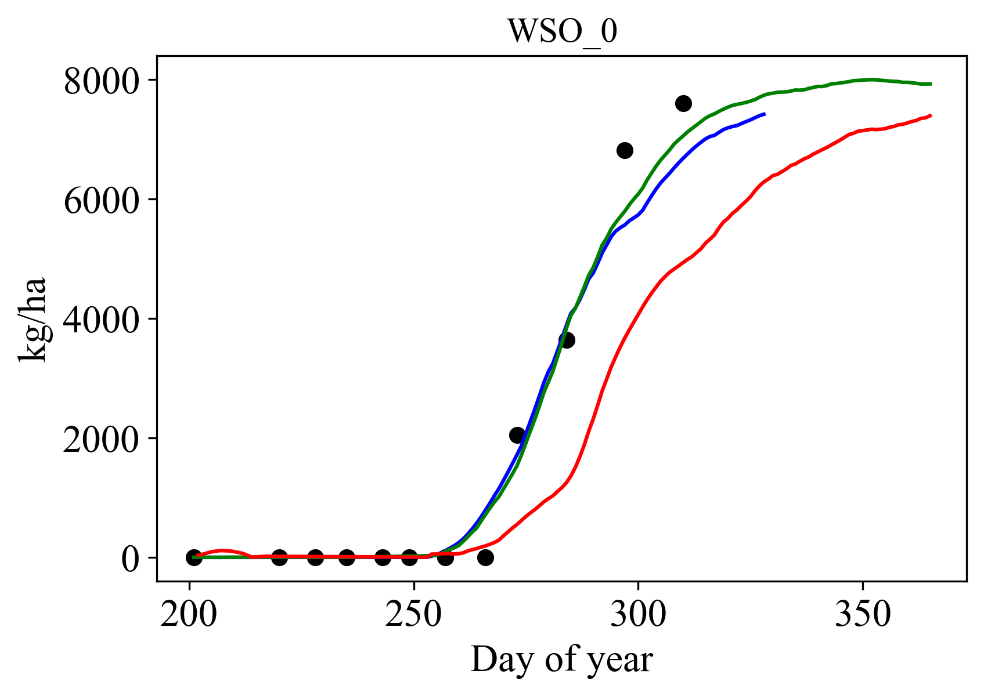
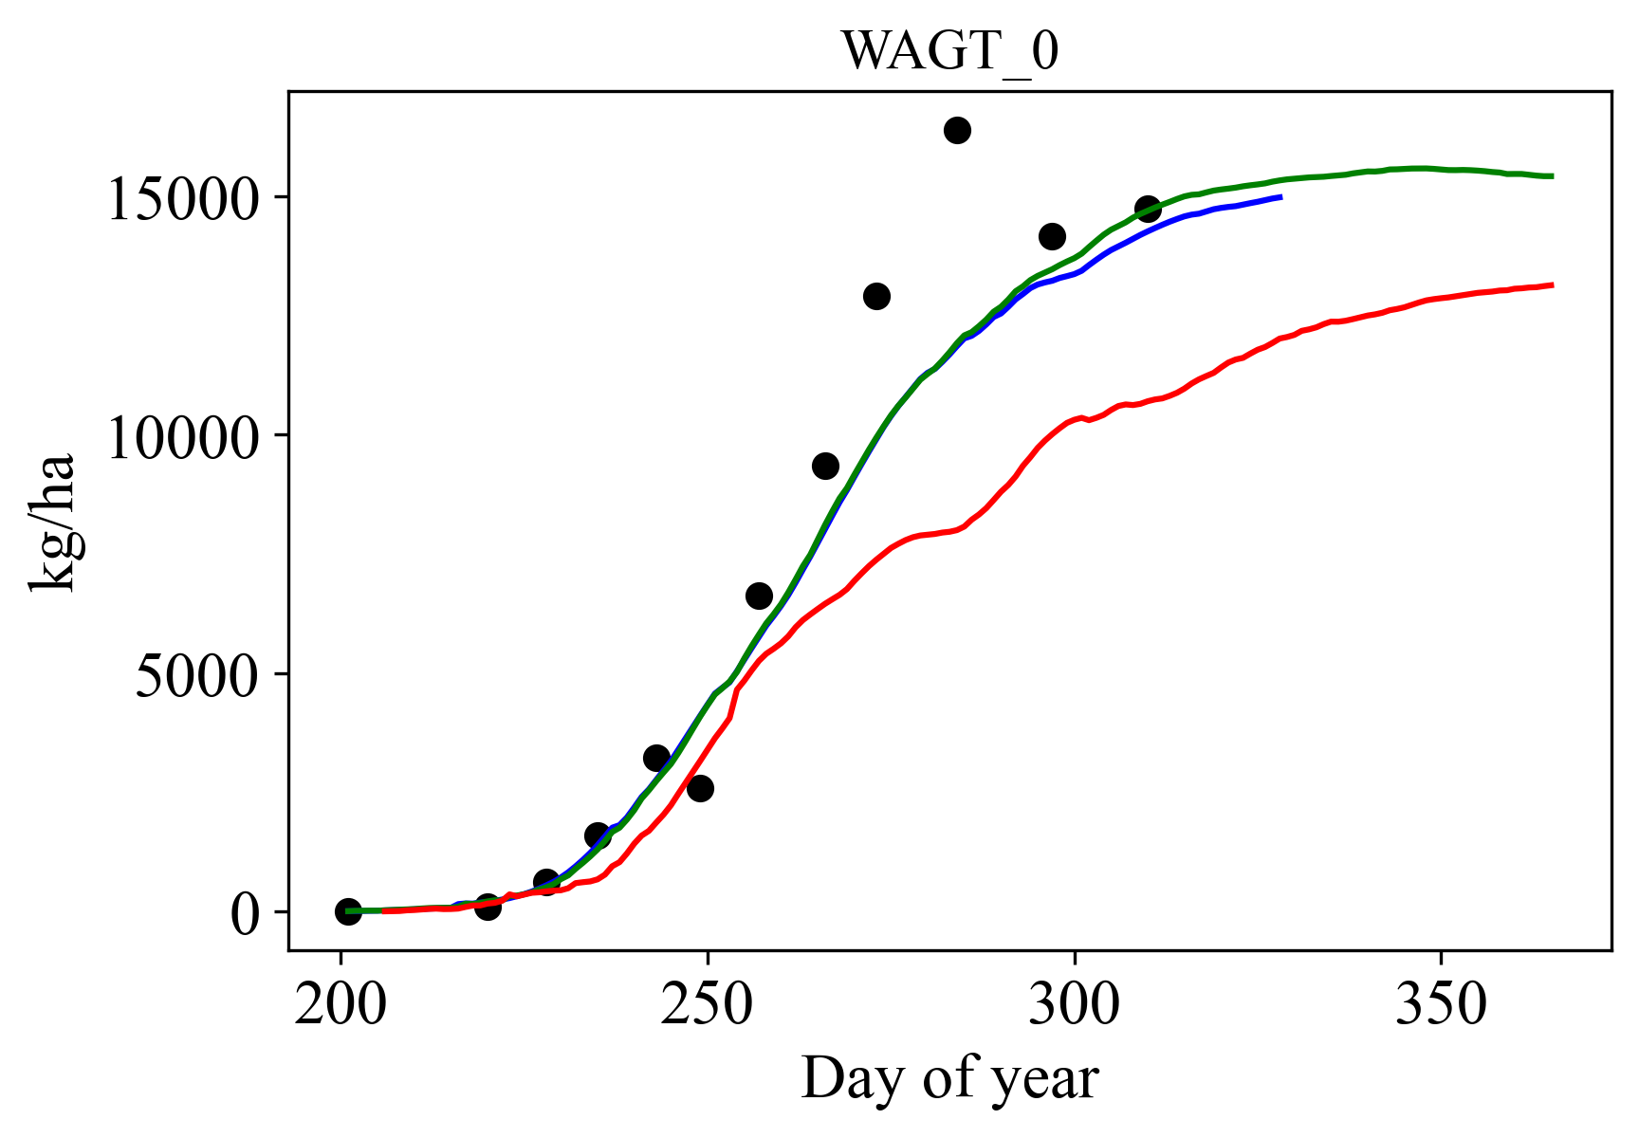
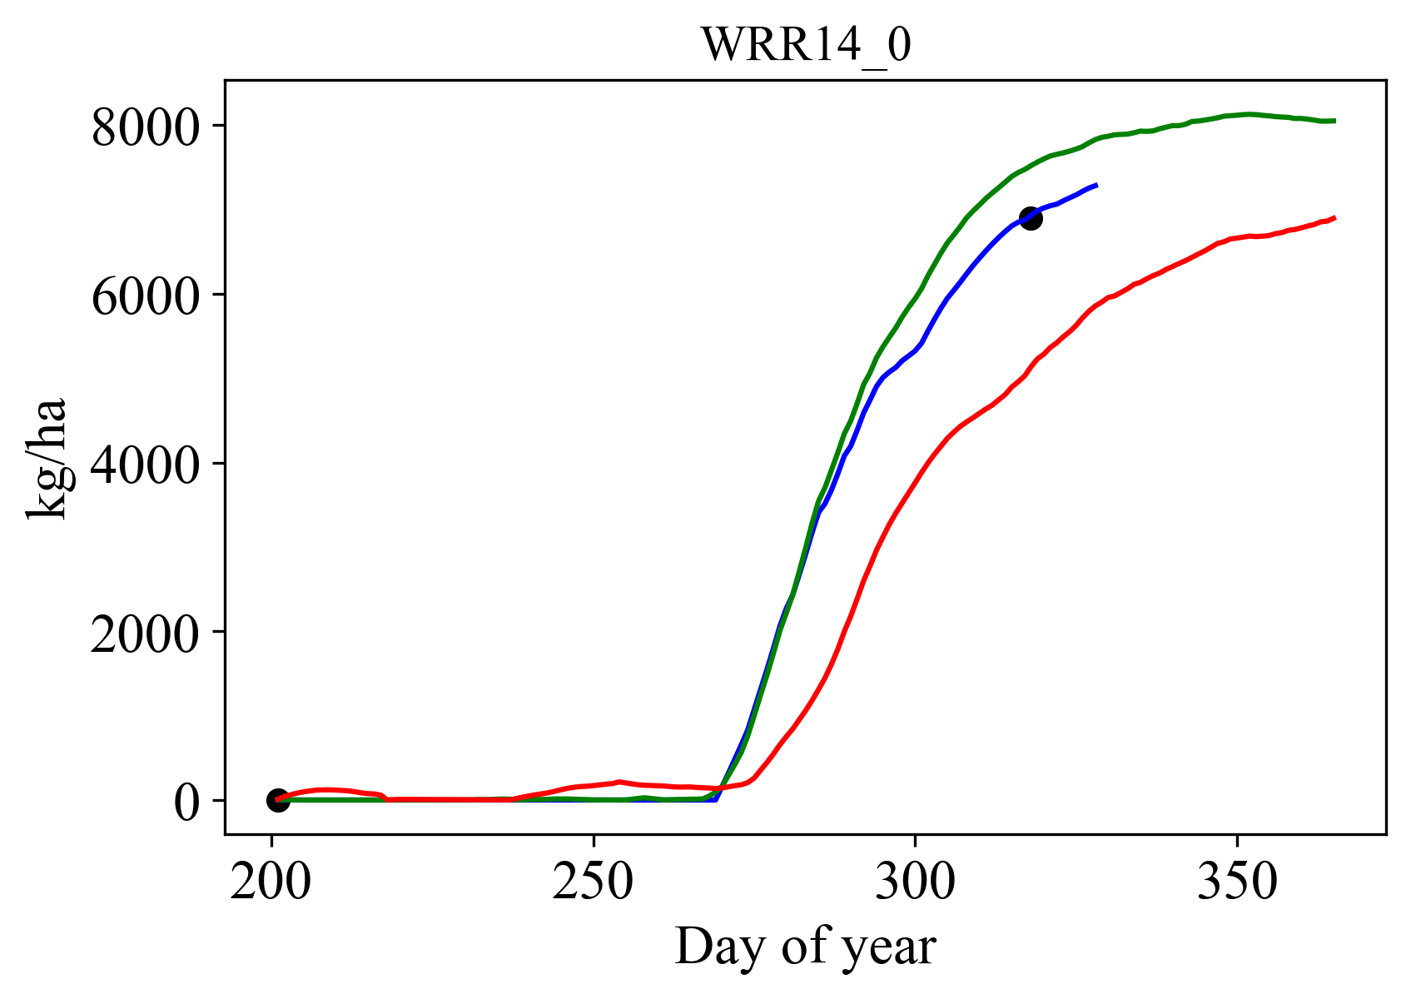
Results and discussion- time series result (failed case)
For question: Can we build a crop model from data and knowledge to improve model performance?
Development stage
Plant area index
Leaf biomass
Stem biomass
Grain biomass
Aboveground biomass
Yield
Note: These results are simulated by DeepOryza_kgml
Notes:
Also, there could be some failed cases if the growth pattern doesn’t follow most samples in the dataset.

Slide 9
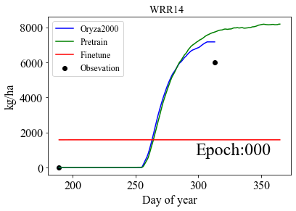
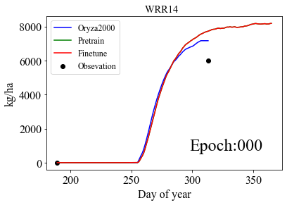
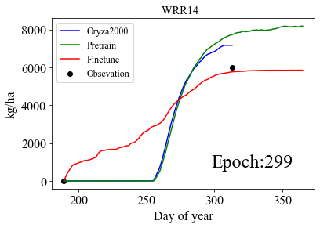
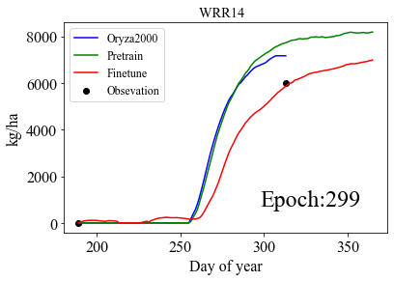
Results and discussion-the effect of knowledge-guided initialization
For question: the effect of domain knowledge (knowledge-guided initialization)
Yield
Yield
Training from scratch:
Knowledge-guided initialization and Finetuning:
(b)
Reasonable initial value
Accelerating the training process
Ensuring results similar to the real crop growth process
Knowledge-guided initialization
Notes:
Now, we’d like to show the effect of domain knowledge.
In this slide, we want to discuss the knowledge-guided initialization)
These images show how the model learn to simulate rice yield as the number of training epochs increases
The two figures on the left depict yield simulations by the scratch-trained model, while the two figures on the right show simulations by the finetuned model.
The scratch-trained model takes a long time to identify the trend in yield simulation, as shown in the figures.
In reality, yield should start accumulating in the later stages of crop growth, as seen in the red region.
However, the scratch-trained model generates yield at the beginning, as seen in the green region, due to lack of observation data between sowing and harvest. As a result, the model struggles to fit the data and simulates the time series yield incorrectly.
On the other hand, finetuning greatly accelerates the training process, allowing the model to quickly identify the correct pattern and generate a simulated curve that is more similar to the real crop growth process.
So we know that knowledge-guided initialization ensures:
the model parameters start from a reasonable initial value, , accelerating the training process and
generating results that are more similar to the real crop growth process because it helps prevent underfitting during periods where there is no observation data

Slide 10
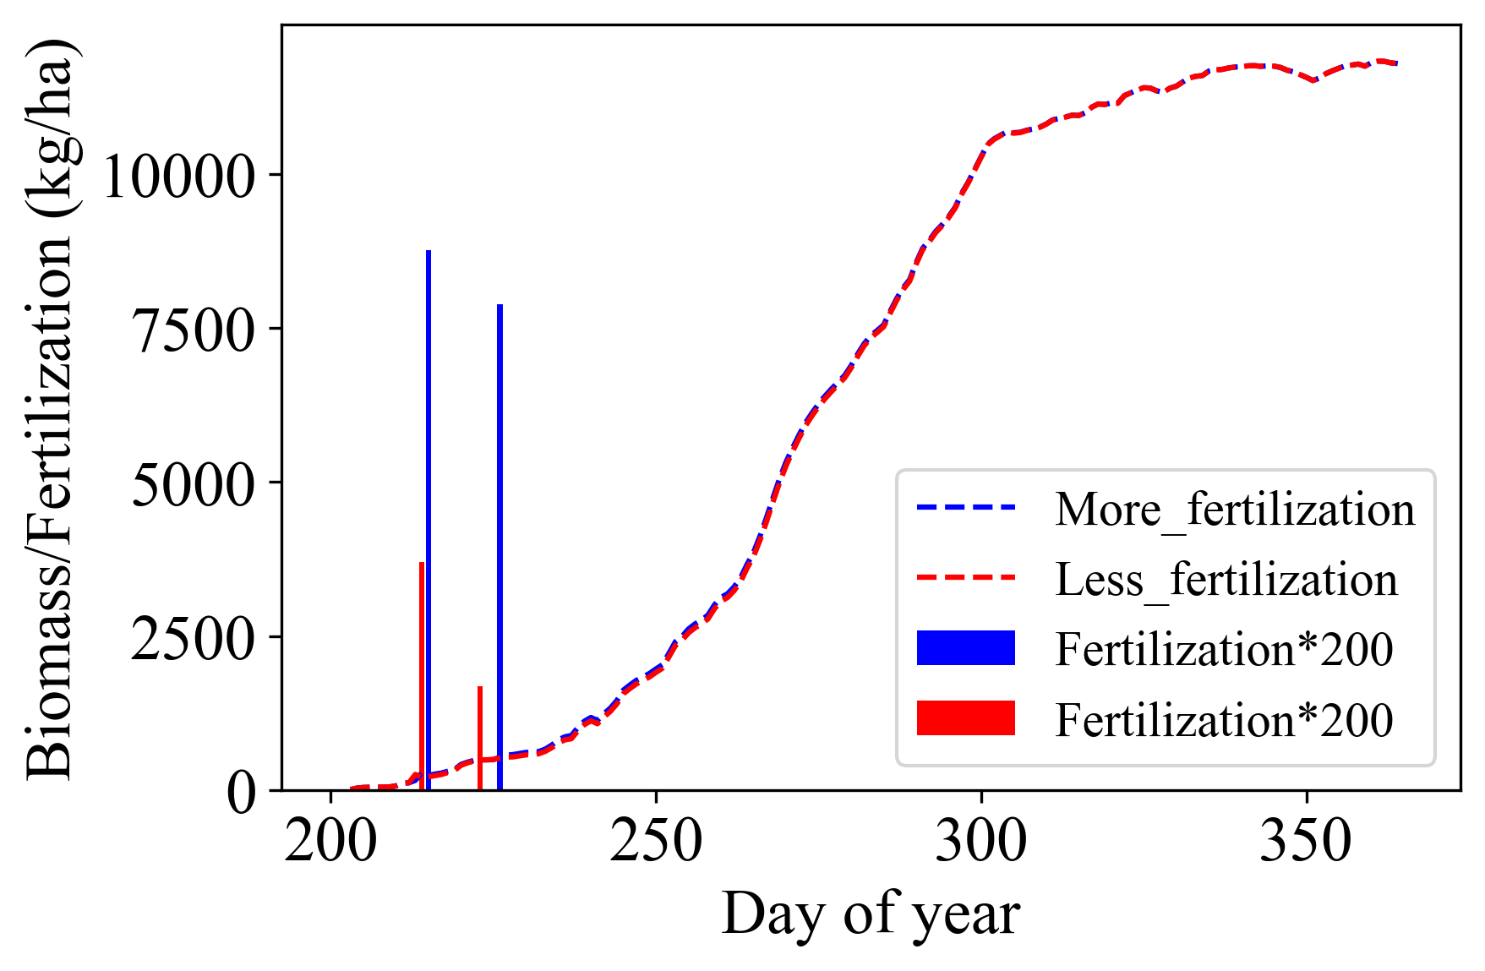
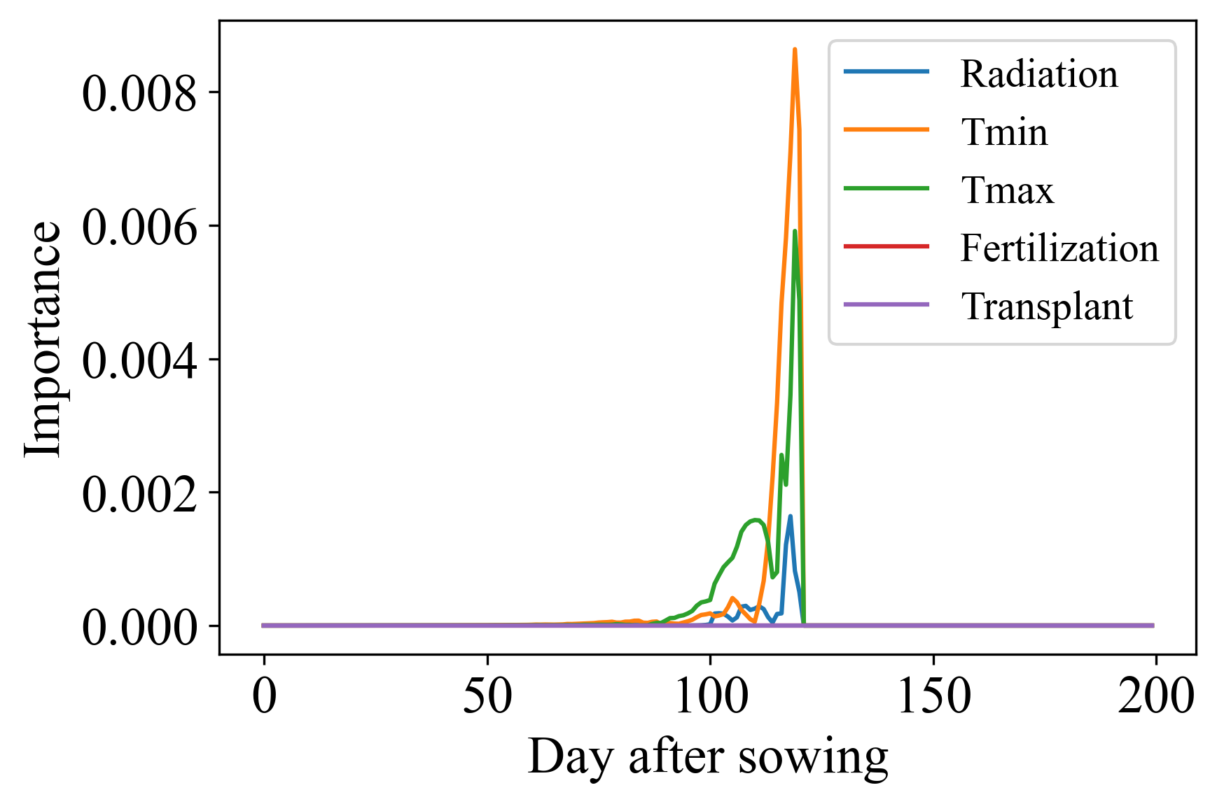
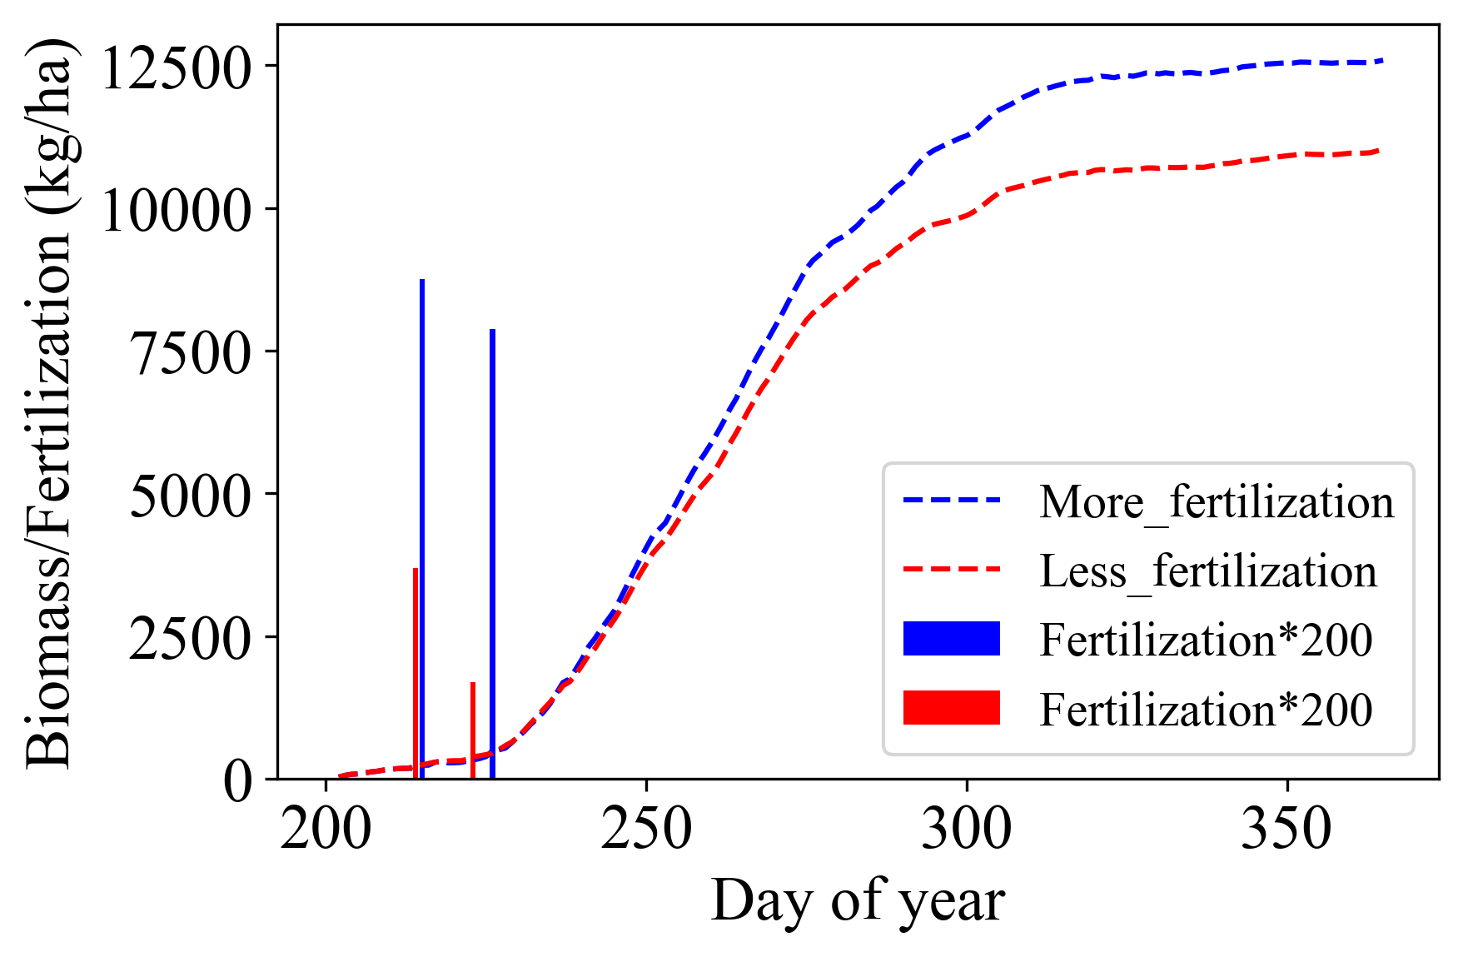
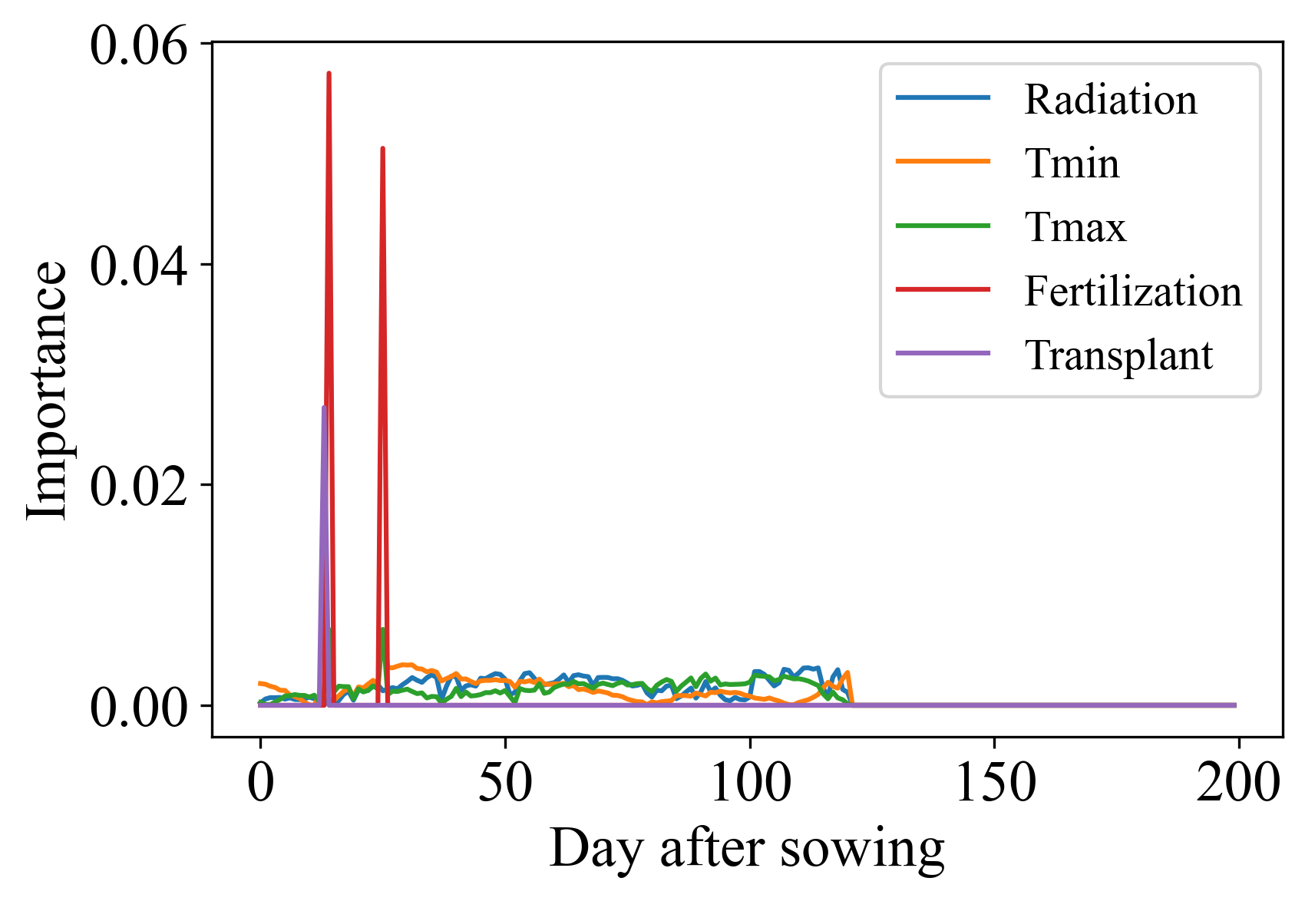
Results and discussion-the effect of knowledge-guided initialization
For question: the effect of domain knowledge (knowledge-guided initialization)
Simulation of biomass
Input importance for biomass
（a）
（c）
early
late
Train from scratch
（b）
（d）
Knowledge-guided initialization and Finetuning:
Knowledge-guided initialization helps to establish the relationship between the input and output variables
Notes:
In addition, the knowledge-guided initialization also helps to establish the relationship between the input and output variables
These two figures represent the above-ground biomass simulated by a DeepOryza model.
One was trained from scratch. And another one used knowledge-guided initialization and finetuning.
We set two cases;
The blue case was applied more fertilization and the red case was applied less fertilization. The other inputs of this two cases are the same.
The dashed lines are simulated biomass of the two cases.
In figure(a), the two dashed lines overlap because the simulated results are almost the same.
It means the model doesn’t respond to the fertilization.
However, when we use the knowledge-guided initialization, the simulated biomass of the two cases will be different. Look the figure(b), more fertilization will produce more biomass.
It means the model can map the fertilization to biomass.
To further explore this issue, we calculated the cumulative gradients of all input toward the simulated biomass on the 120th day. The gradients represent the importance of input for the output.
The results showed that only the weather-related inputs (such as the radiation and temperature) in the late period had an effect on the biomass, while fertilization and transplanting had no contribution, and the weather in the early period also had no contribution.
This indicates that the model doesn’t learn the effects of fertilization and has lost the long dependencies between variables on time series data.
When the knowledge-guided initialization was used, the results are different.
Figure(d) shows that fertilization and transplanting both have significant contributions to the biomass, and the weather data in the whole time period contribute to the simulation results
These results indicate that the knowledge-guided initialization also helps to establish the relationship between the input and output variables

Slide 11
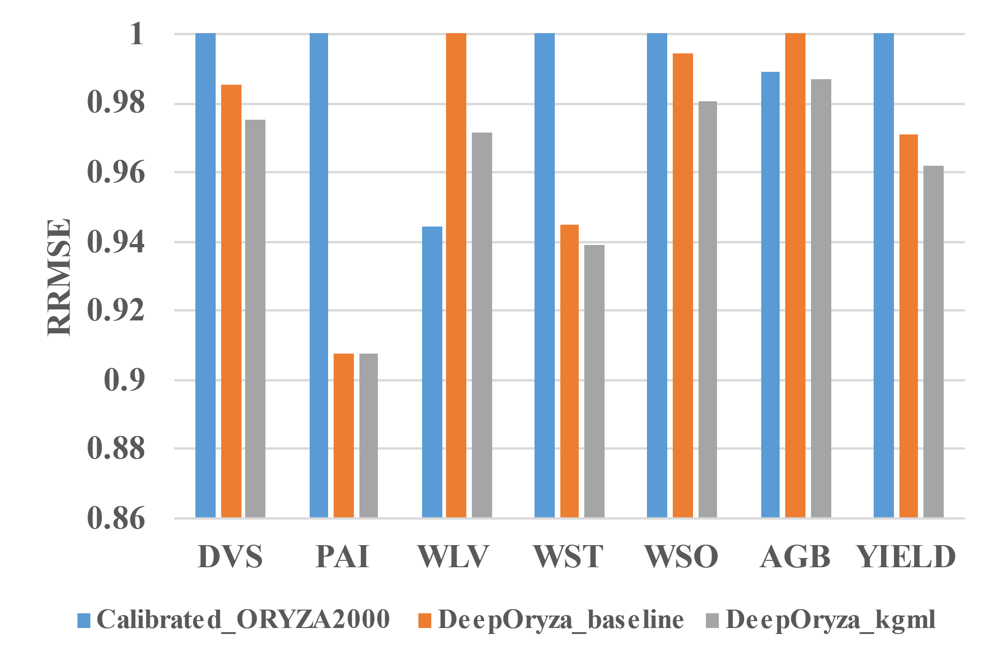
Results and discussion-the effect of knowledge-guided structure
For question: Can we build a crop model from data and knowledge to improve model performance?
Fig. Average performances on training and testing set in two years(RRMSE，normalized RMSE)
DeepOryza performs better than ORYZA2000 in most variables
DeepOryza_kgml performs better than DeepOryza_baseline
KGML model could perform better than process-based model.
Notes:
Another question is how the DeepOryza perform against the processed-based model.
After pretraining and finetuning, the models were test on the real dataset.
This figure shows normalized RMSE of the results on the real dataset.
We can see that DeepOryza performances better than ORYZA2000 in most variables.
DeepOryza_kgml performs better than DeepOryza_baseline
So the results show that KGML model could perform better than process-based model.

Slide 12
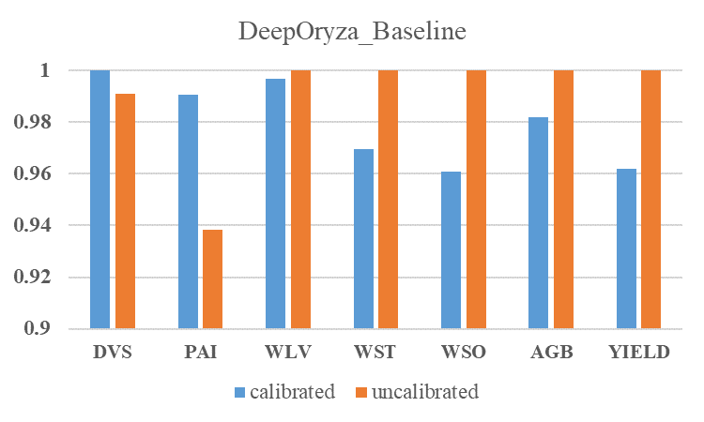
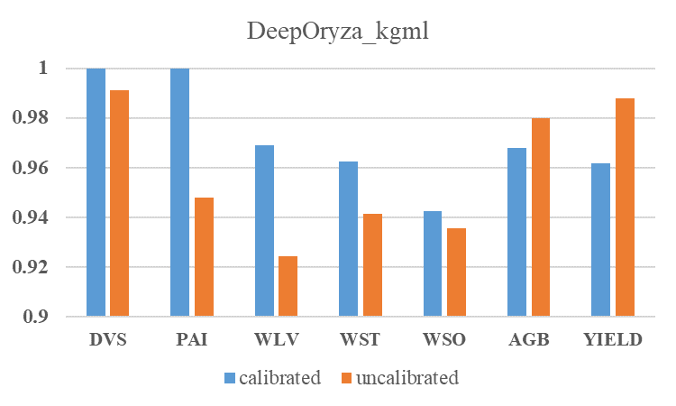
Results and discussion-the effect of knowledge-guided structure
For question: How could domain knowledge assist in building new crop models?
Is it necessary to calibrate PB model before generating synthetic dataset?
biomass-related variable
RRMSE
RRMSE
(a)
(b)
Fig. Accuracy of model with different structure. (a)DeepOryza_baseline, (b)DeepOryza_kgml
Without calibration：
DeepOryza_baseline deteriorates significantly
DeepOyza_kgml changes slightly
It indicates that Knowledge guided Structure can reduce the dependence of the model on the initial parameters.
Notes:
Finally, we investigated the necessary of calibrating a process-based model before using it to generate synthetic dataset. Because the calibration is really time-consuming.
So we generated two synthetic dataset, one used the calibrated process-based model and the other used the uncalibrated model
This figure shows the performance of the DeepOryza_baseline.
The blue bar shows the normalized RMSE of the DeepOryza_baseline model pretrained on a calibrated synthetic dataset, while the orange bar represents the RMSE of the same model pretrained on an uncalibrated synthetic dataset
You can find that RMSE of biomass-related variables increases when using uncalibrated synthetic dataset, indicating that calibrating is necessary before generating synthetic dataset.
But when use the knowledge structure, the RMSE changes slightly. The
indicating that the accuracy of biomass-related variables remains almost unchanged, regardless of whether the synthetic dataset was calibrated or not.
Maybe the structure have constraint that can decrease the requirement of calibration.
But this conclusion is still preliminary because the structure simple and the dataset is small.

Slide 13
Summary
KGML model could perform better than ORYZA2000
Knowledge-guided initialization
helps establish the relationship between outputs and inputs
speeds up the training process
makes the simulation results more similar to crop growth patterns
Knowledge-guided structure
improves model performance
decreases the requirement for calibration
Notes:
That’s all about knowledge-guided machine learning model for crop growth modeling.
Here is the summary. Thank all of you.
Does anyone have questions?
Although I am not there, my supervisor Ioannis is there now,.
Thank you Ioannis for you help in my research and life.

Slide 14
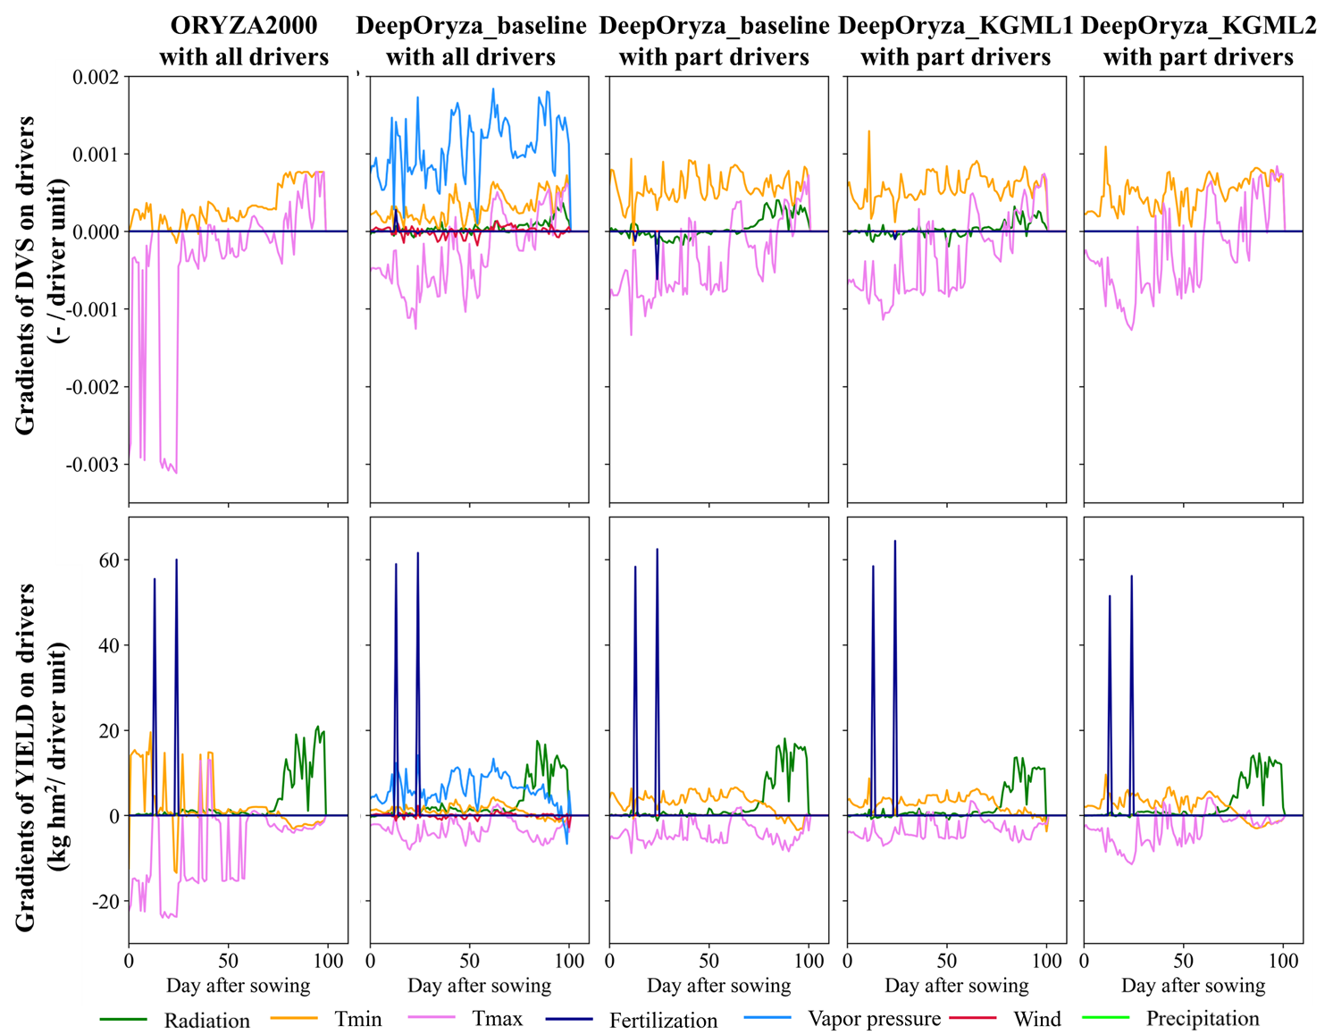
Some ongoing works

